Slide 1
Making Payments Fun
Justin Woo
[Developer Advocate]
Venmo + Braintree + PayPal
juwoo@paypal.com
@jzwoo
ppd.io/dn

Slide 2
Making Payments Fun

Slide 3
A Credit Card Form walks
into a bar……
Making Payments Fun

Slide 4
A Credit Card Form walks
into a bar……
A Talk on Credit Card Forms
A series of Bad Jokes
by
Justin Woo
Braintree Developer Advocate

Slide 5
A Credit Card Form walks
into a bar……

Slide 6
he says to the bartender,
“I’ve been having a hard time meeting people”
the bartender says:
“Wait, aren’t you supposed to be good at generating…”

Slide 7
“interest”

Slide 8
THANK YOU!

Slide 9
Things
Justin Thinks
merchants
do to NOT make it fun to pay for stuff

Slide 10
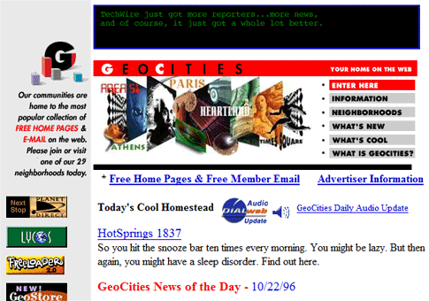

Slide 11
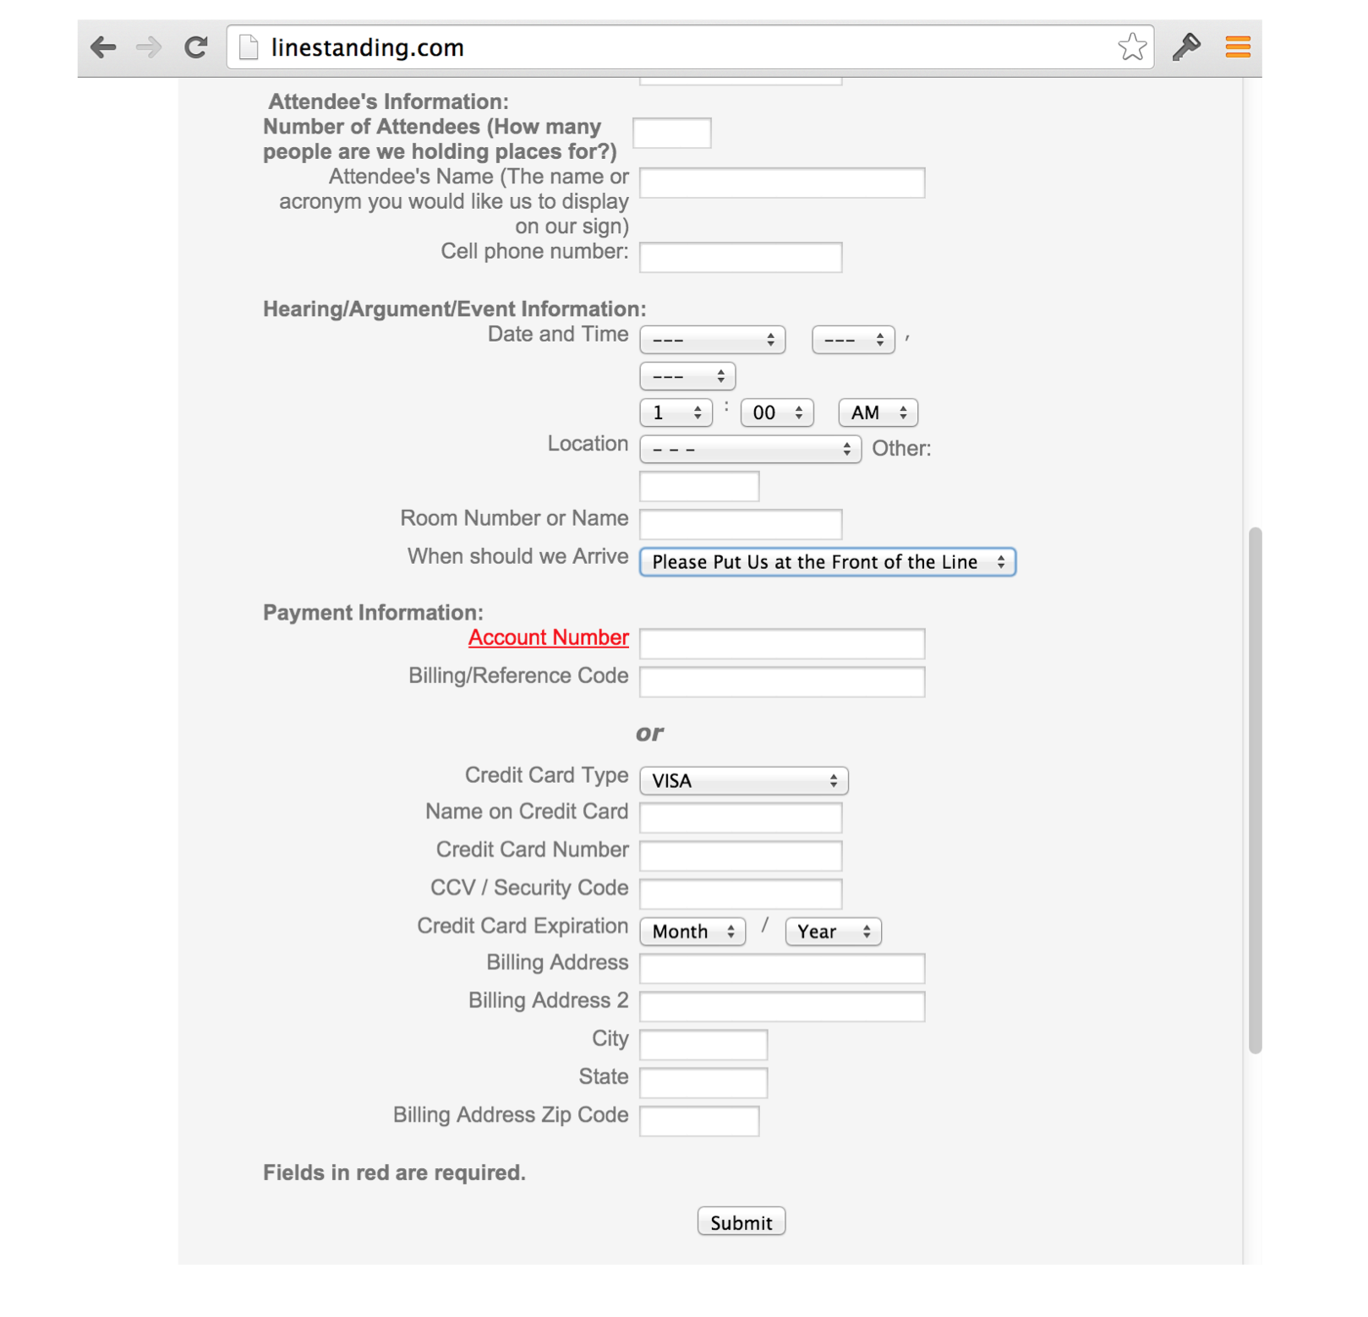

Slide 12
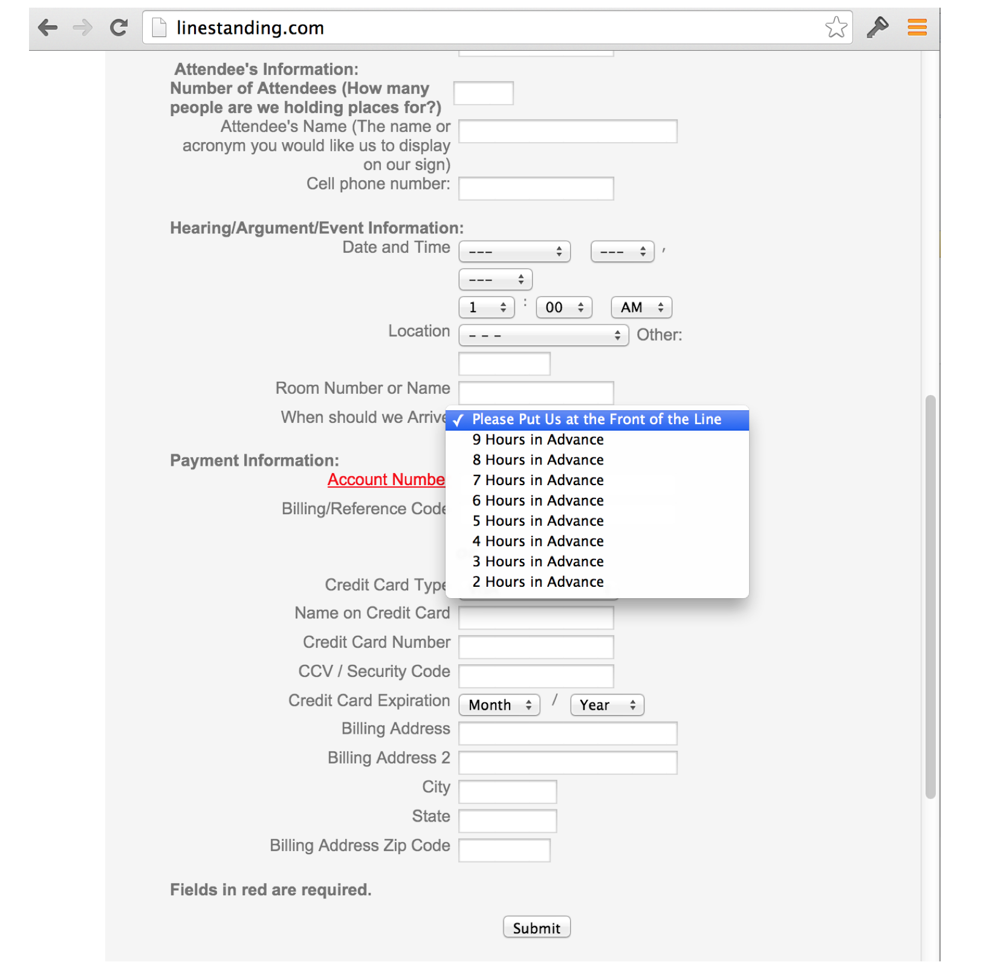

Slide 13
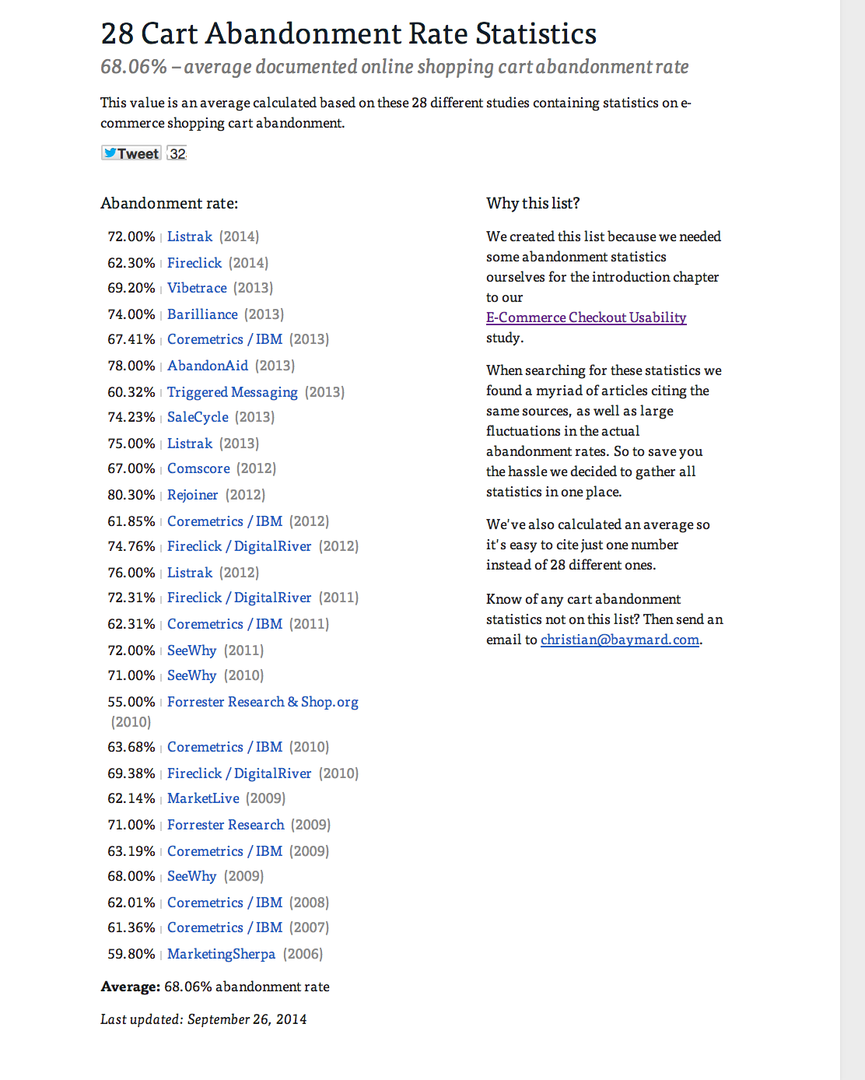

Slide 14
Add a Captcha

Slide 15
Captcha
Completely Automated Public Turing Test To Tell Computers and Humans Apart

Slide 16
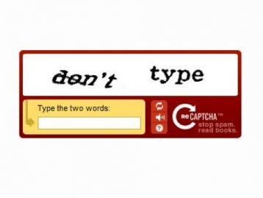

Slide 17
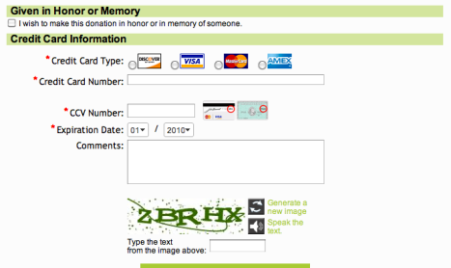

Slide 18
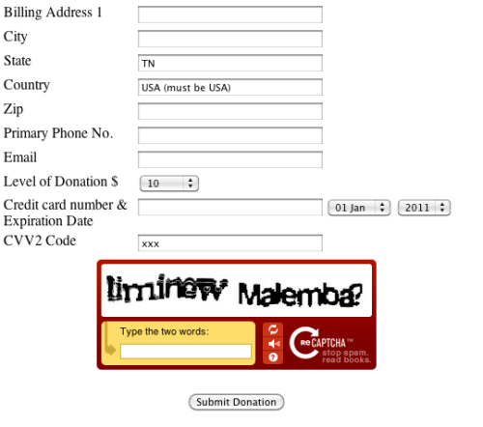

Slide 19
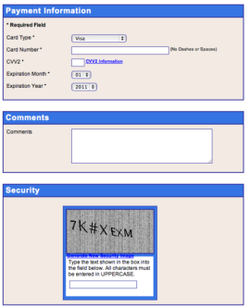

Slide 20
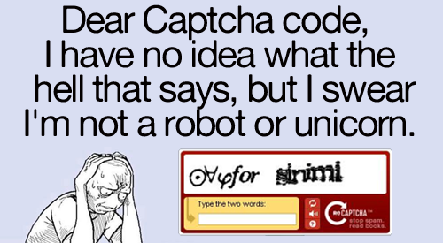

Slide 21
Ask users to register…

Slide 22
Ask users to register..
before purchasing

Slide 23
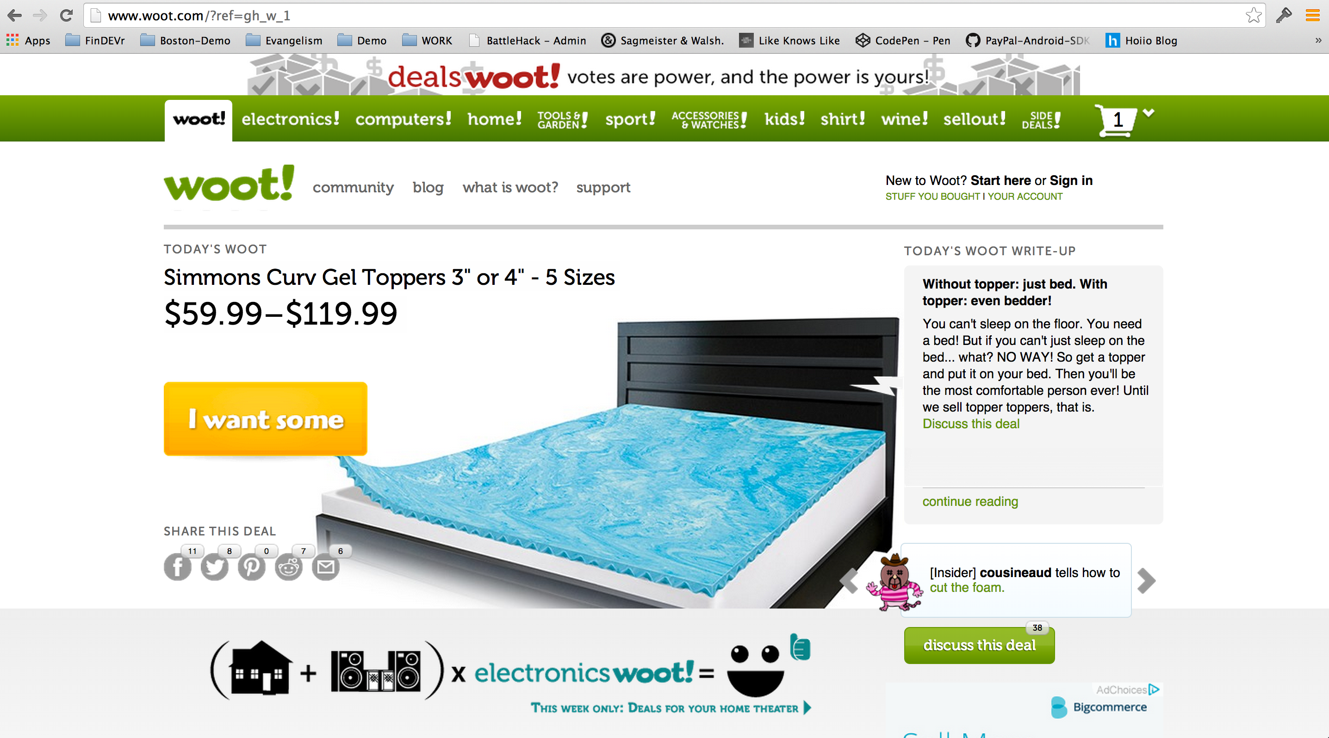

Slide 24
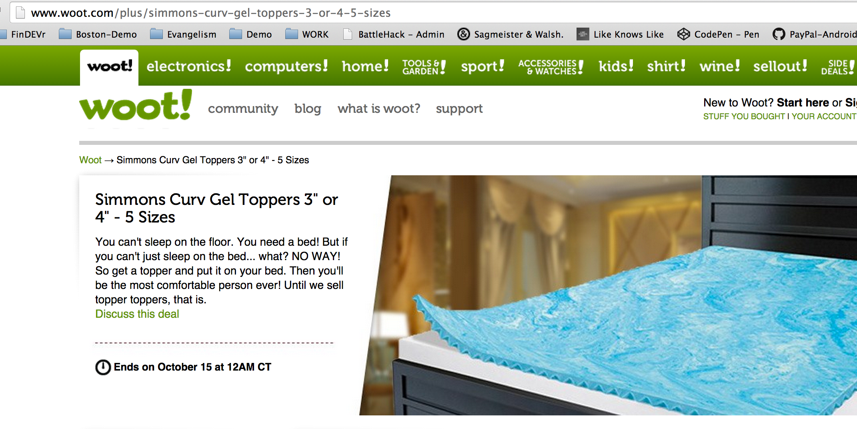

Slide 25
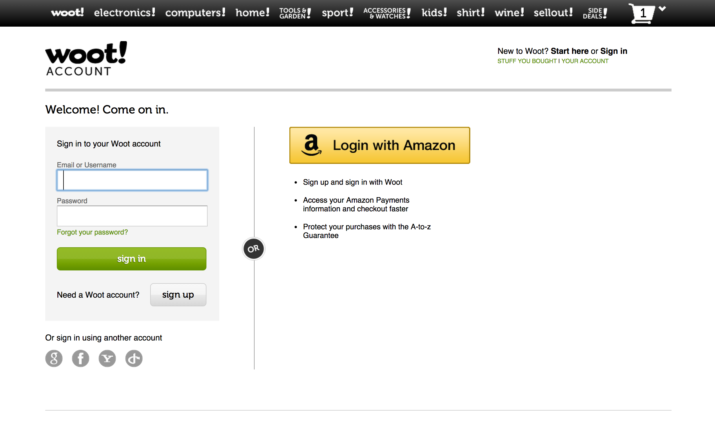

Slide 26
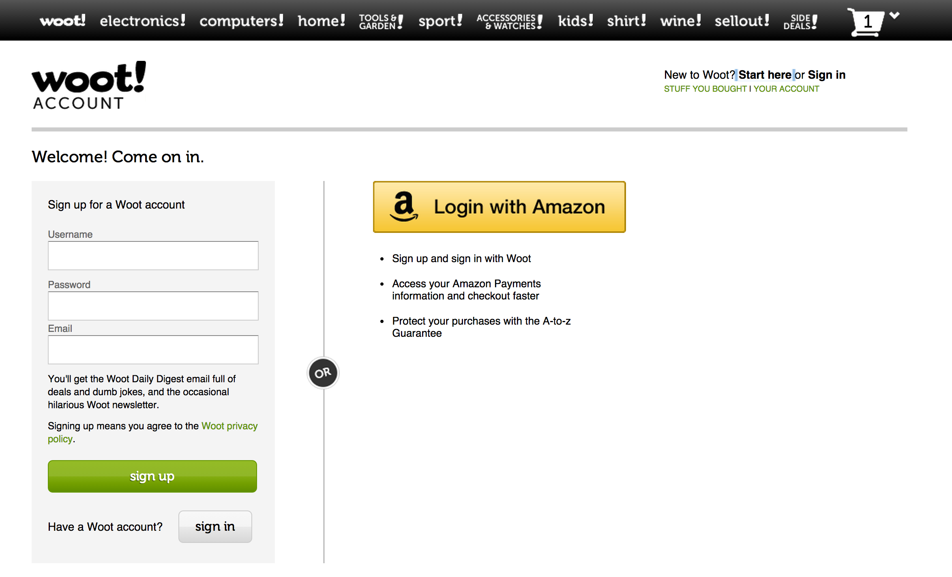

Slide 27
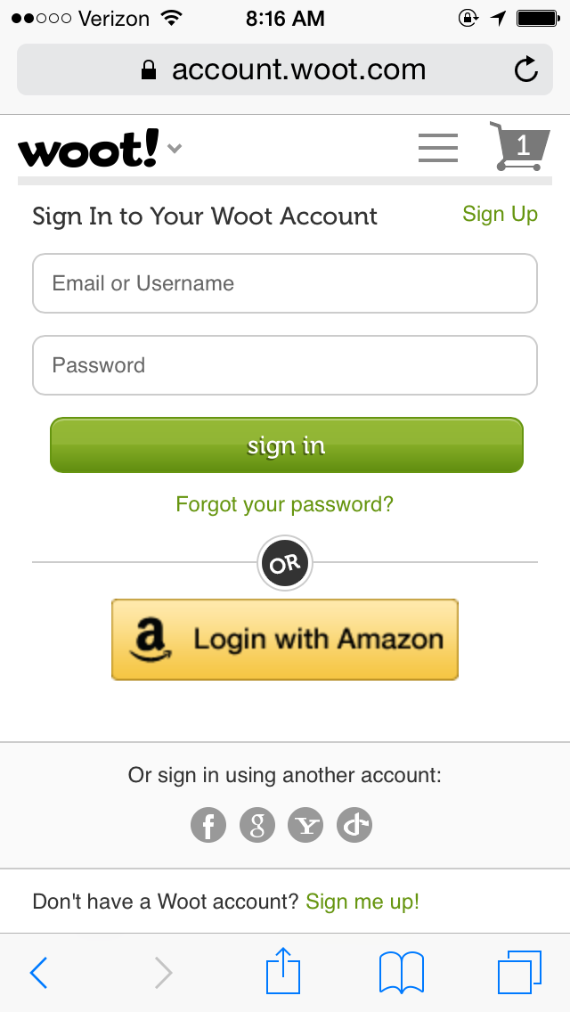

Slide 28
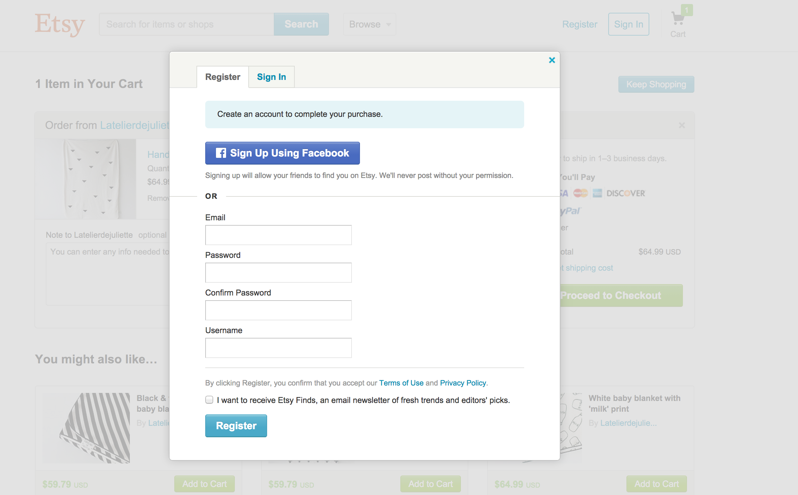

Slide 29
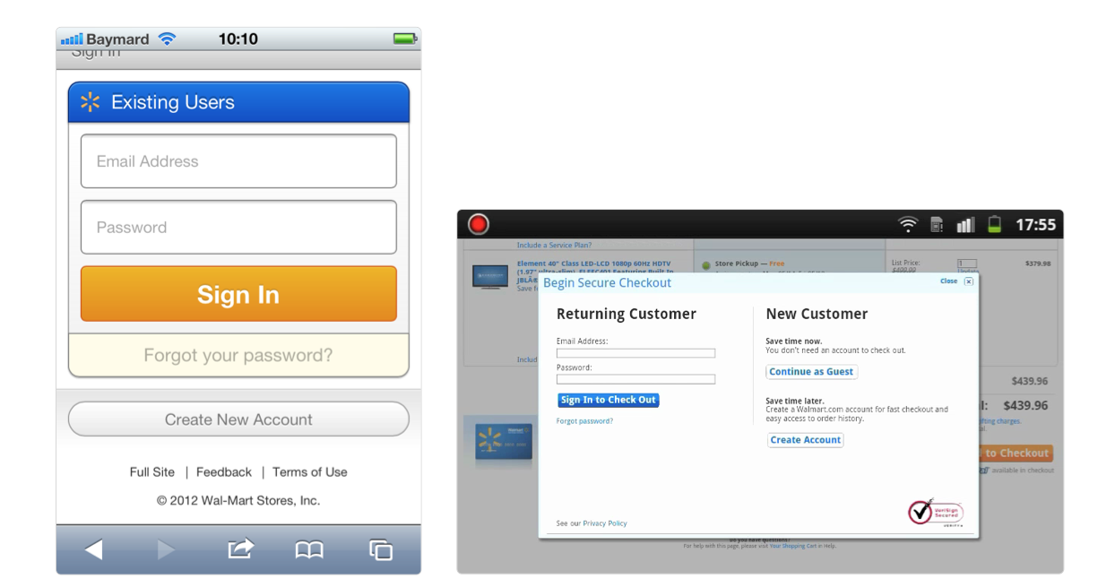

Slide 30
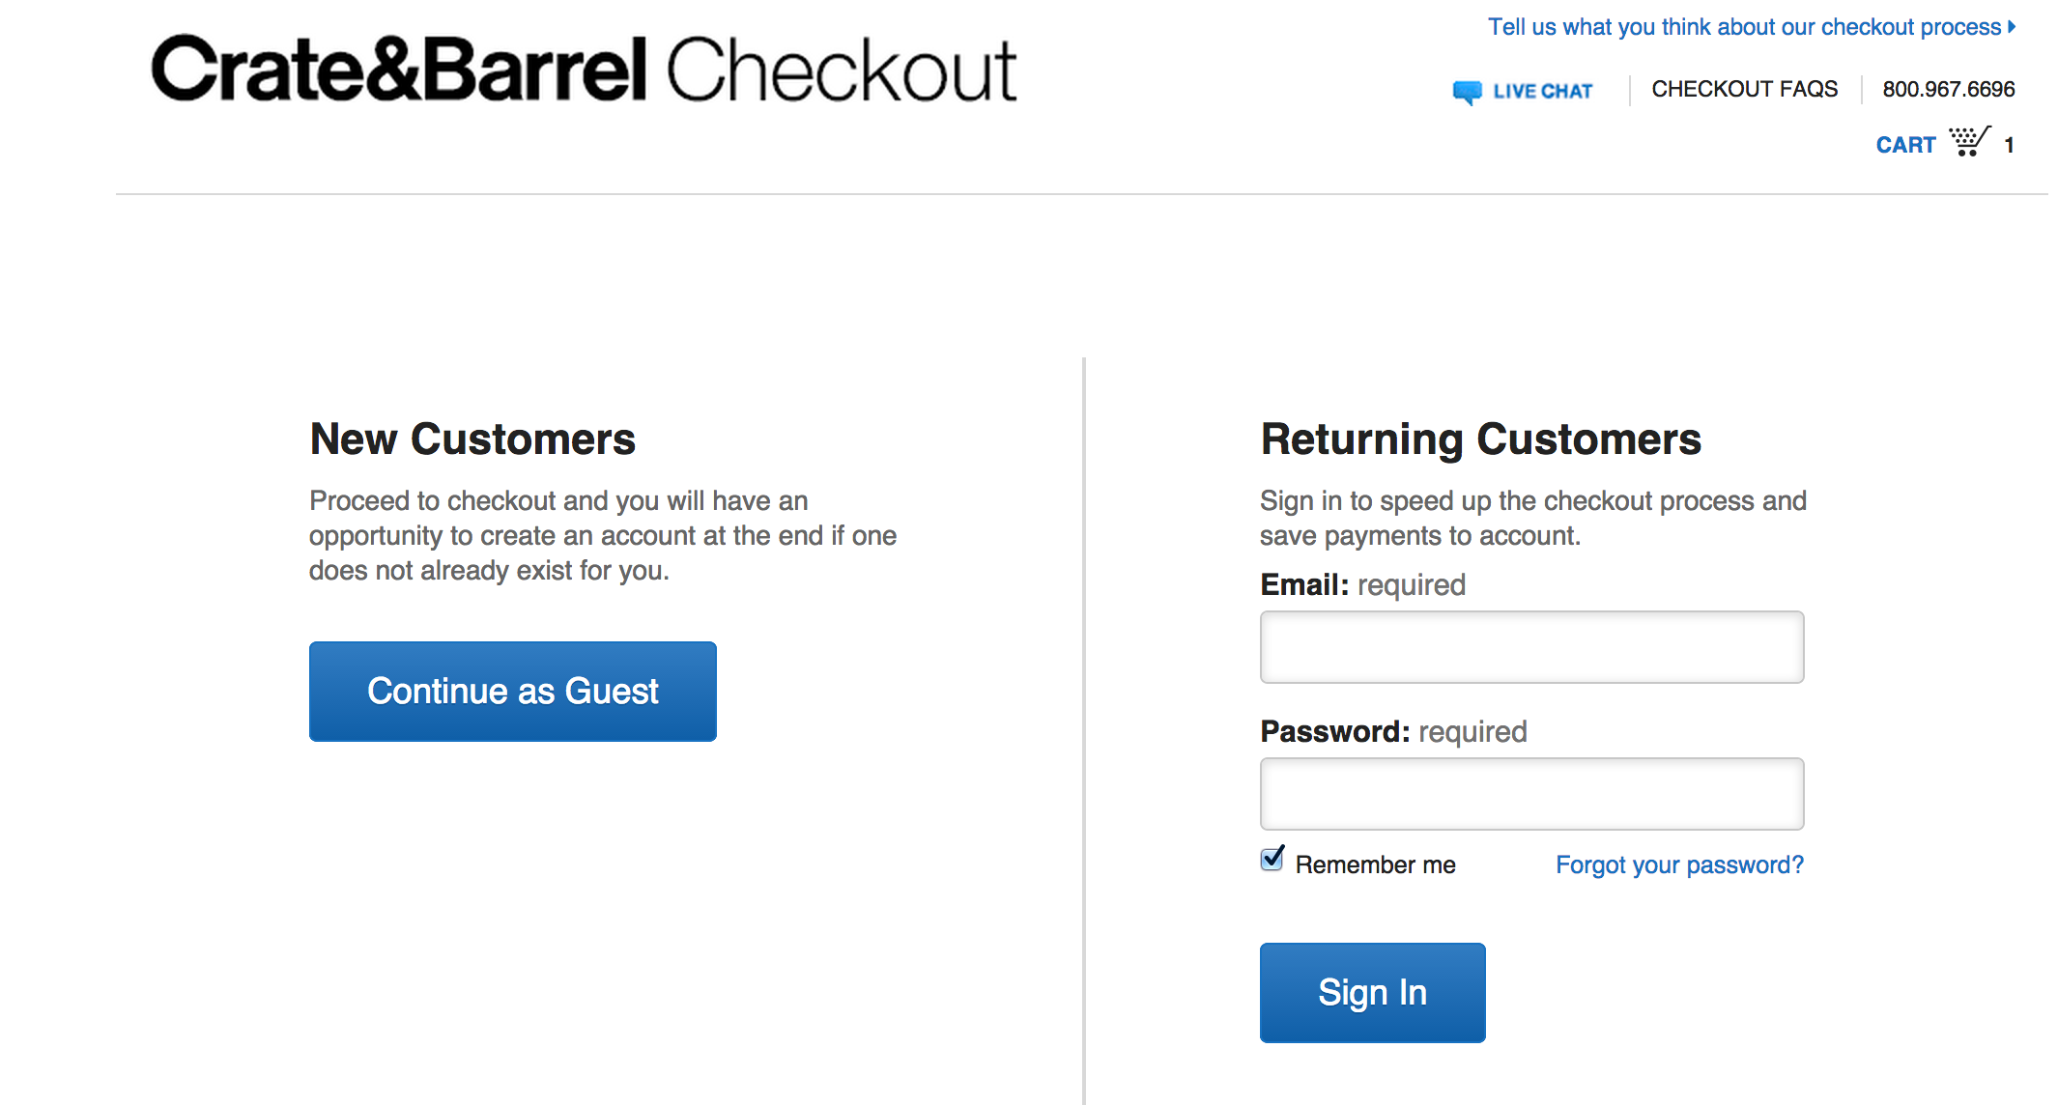

Slide 32
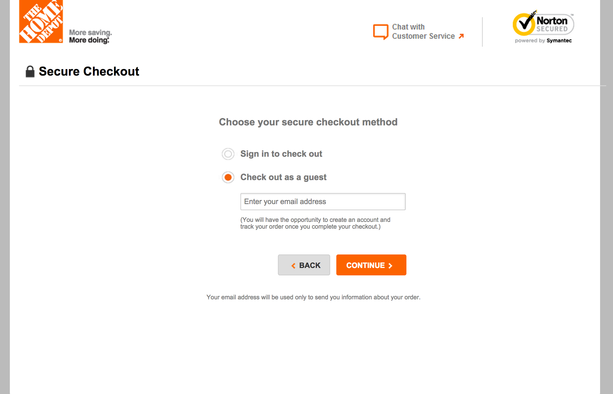

Slide 33
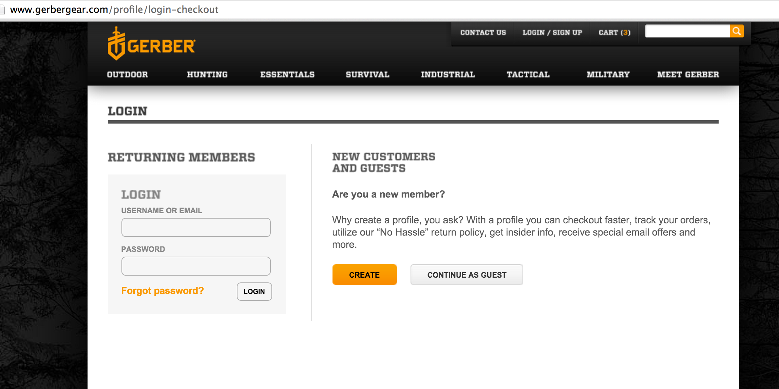

Slide 34
Forcing users to download Native app

Slide 35
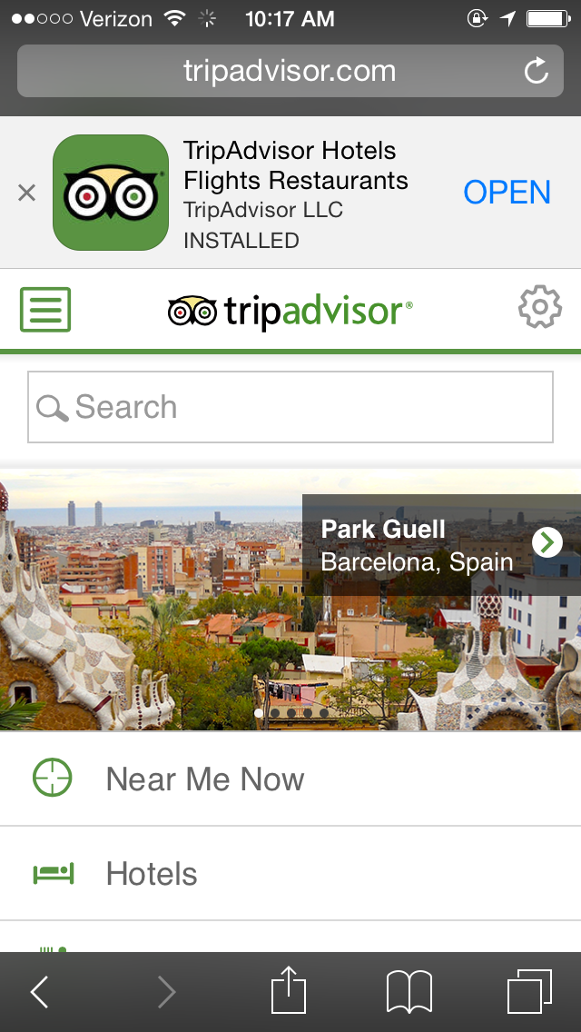

Slide 36
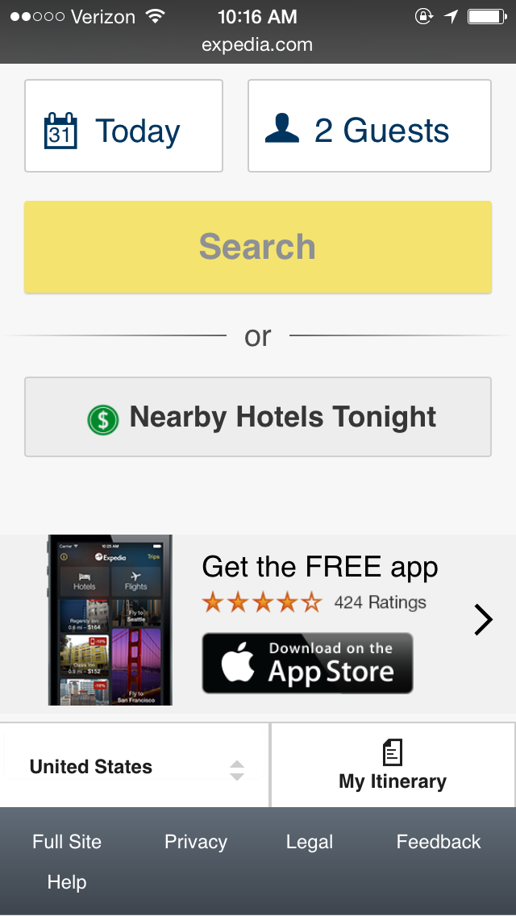

Slide 37
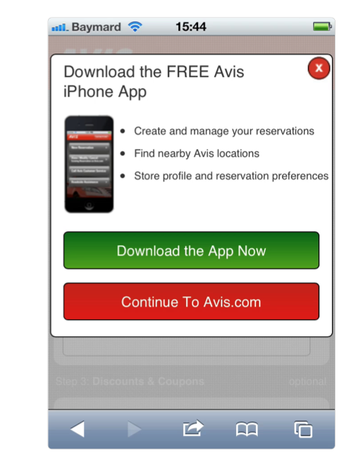

Slide 38
A Credit Card Form walks
into a bar……

Slide 39
the bartender says,
“Why do you keep coming in here day after day ?”
The credit card form looks at him miserably says
“I’m just looking for some ………

Slide 40
“validation”

Slide 41
Don’t Autodetect Credit Card Type

Slide 42
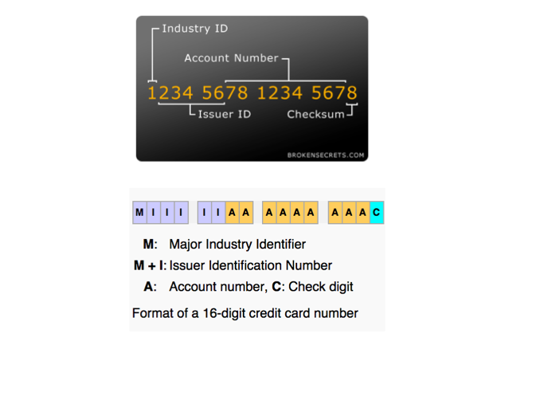

Slide 43
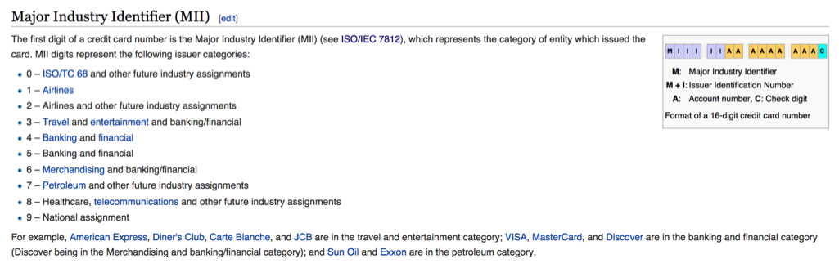

Slide 44
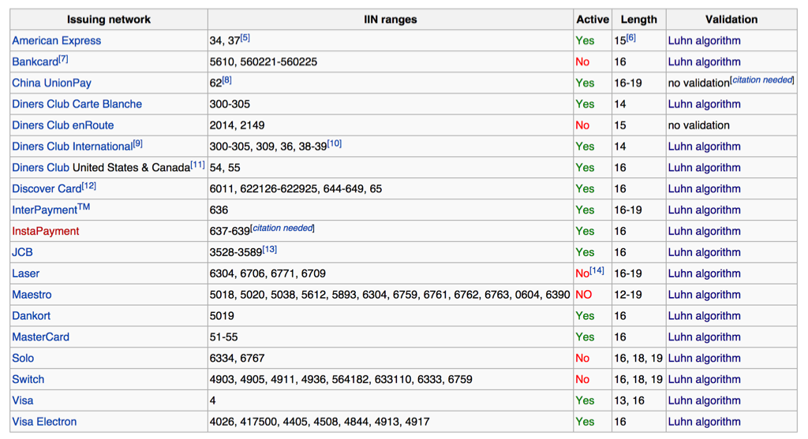

Slide 45
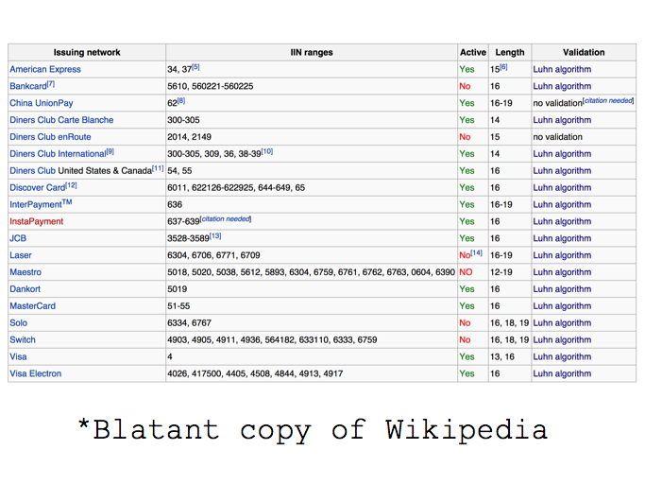

Slide 47
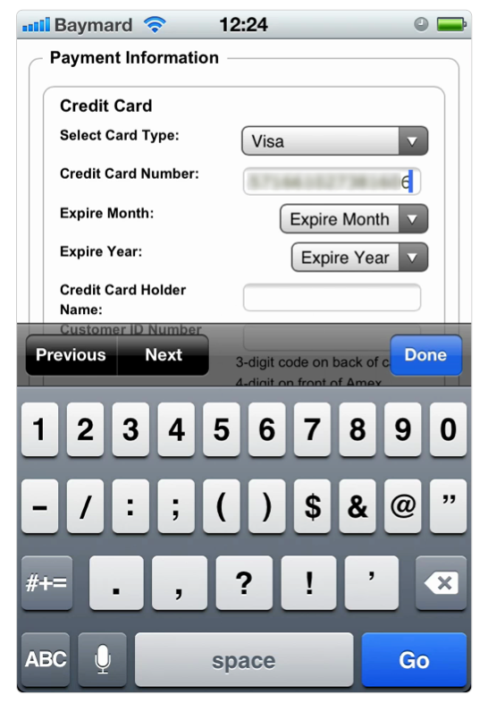

Slide 48
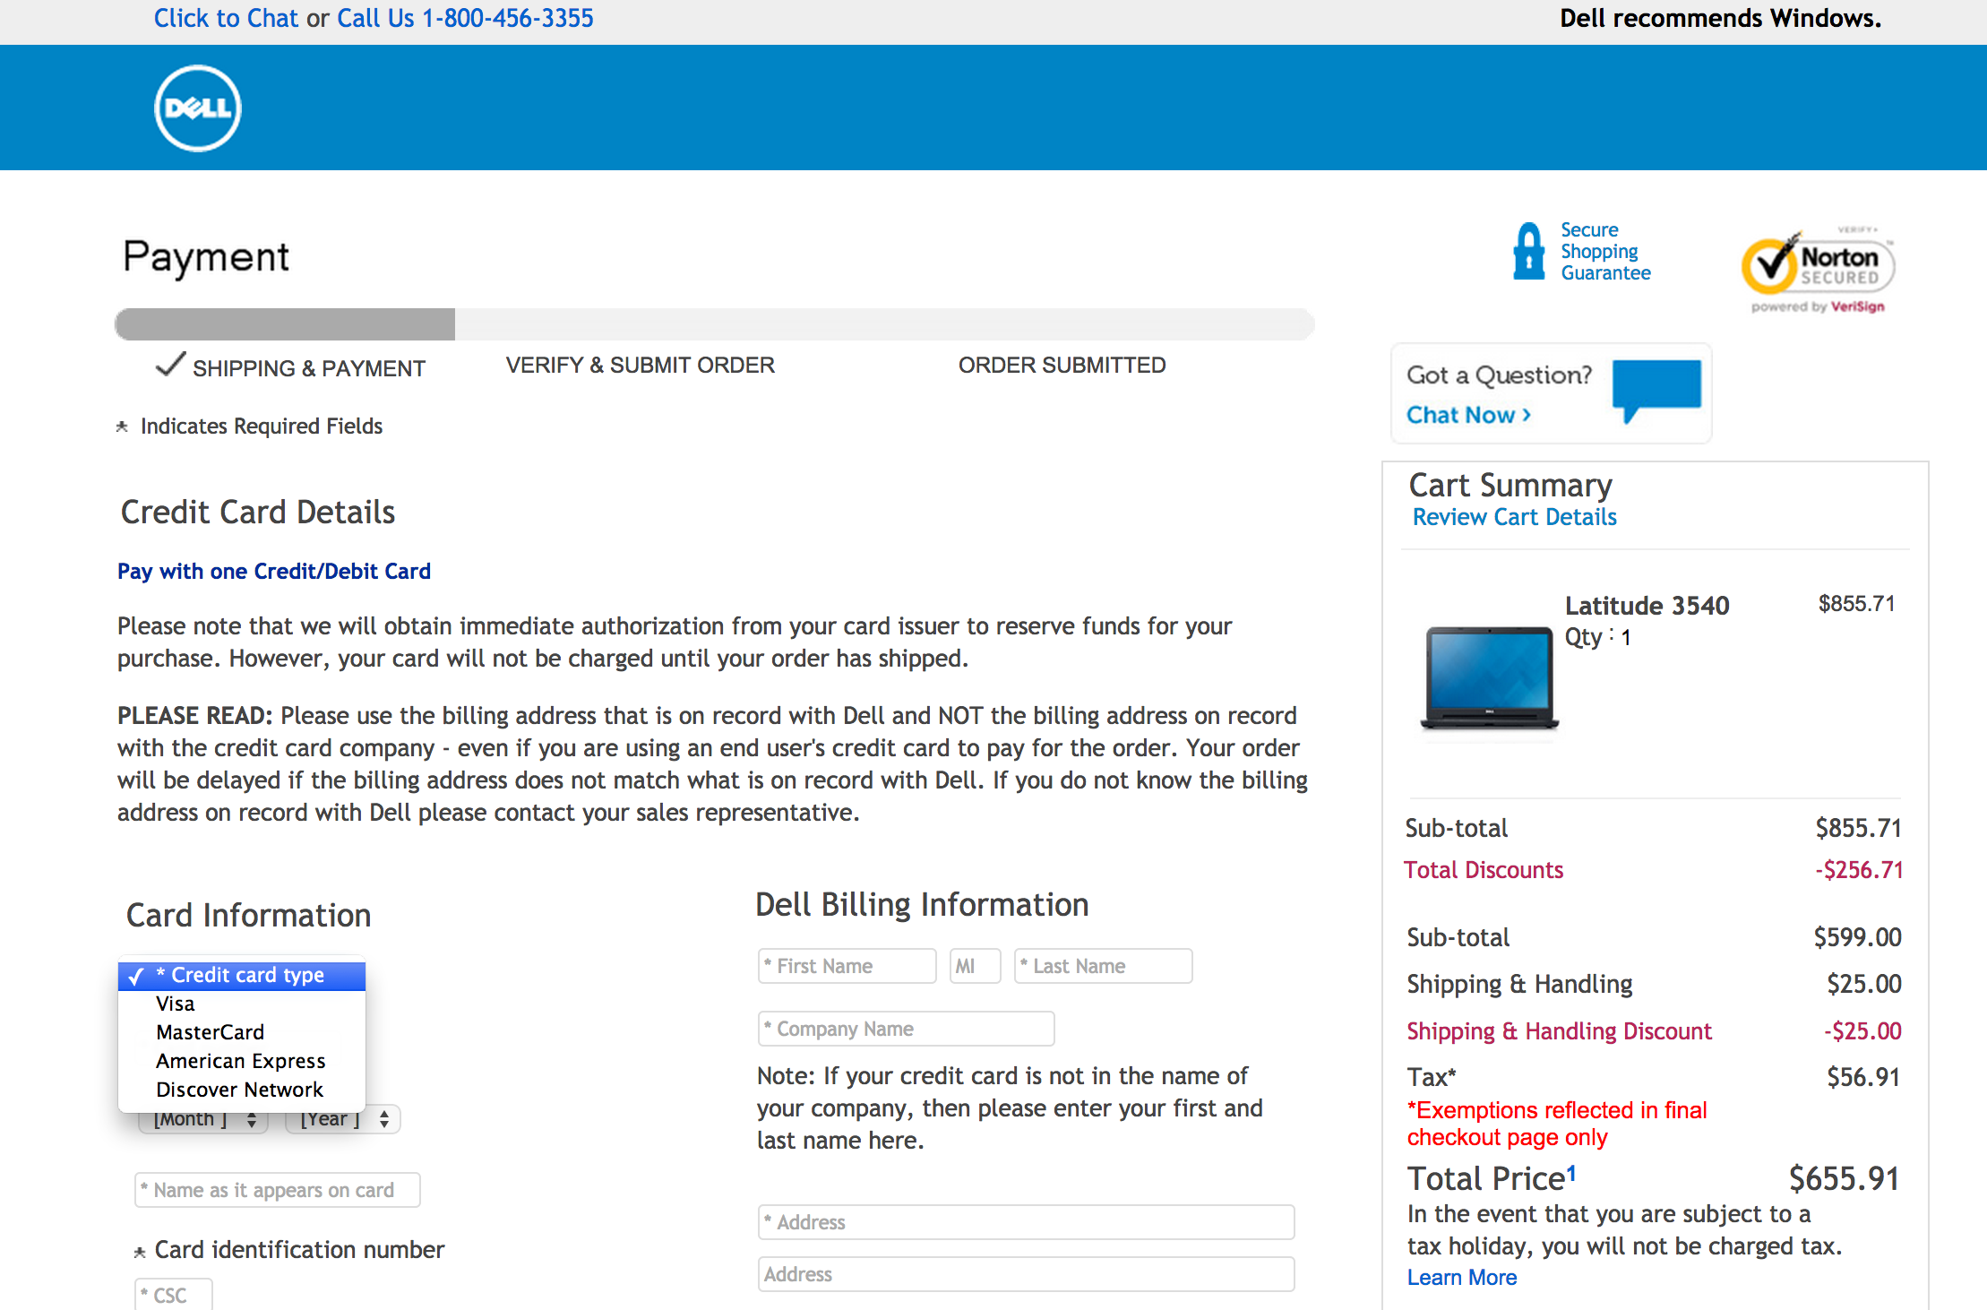

Slide 49
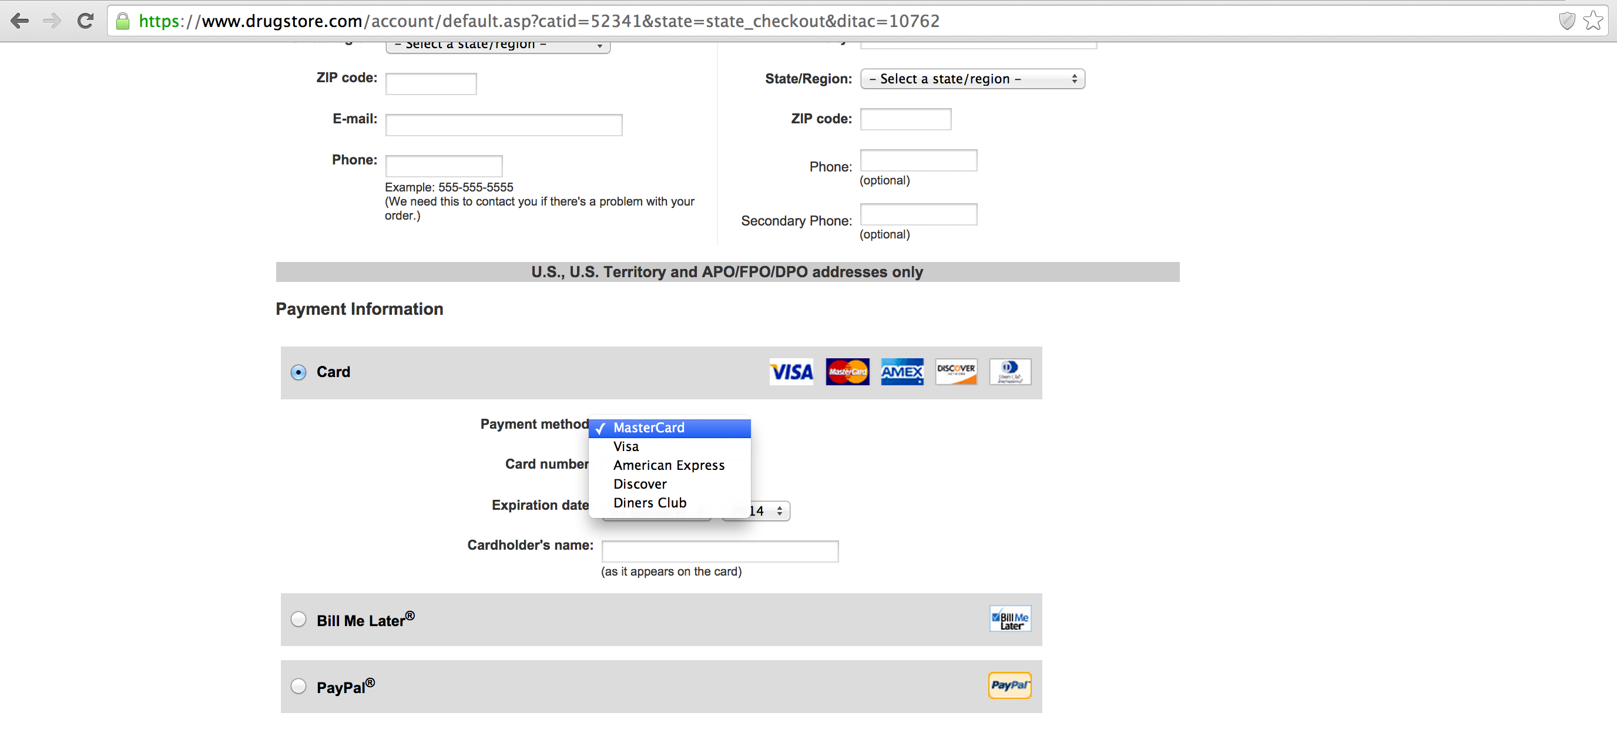

Slide 50
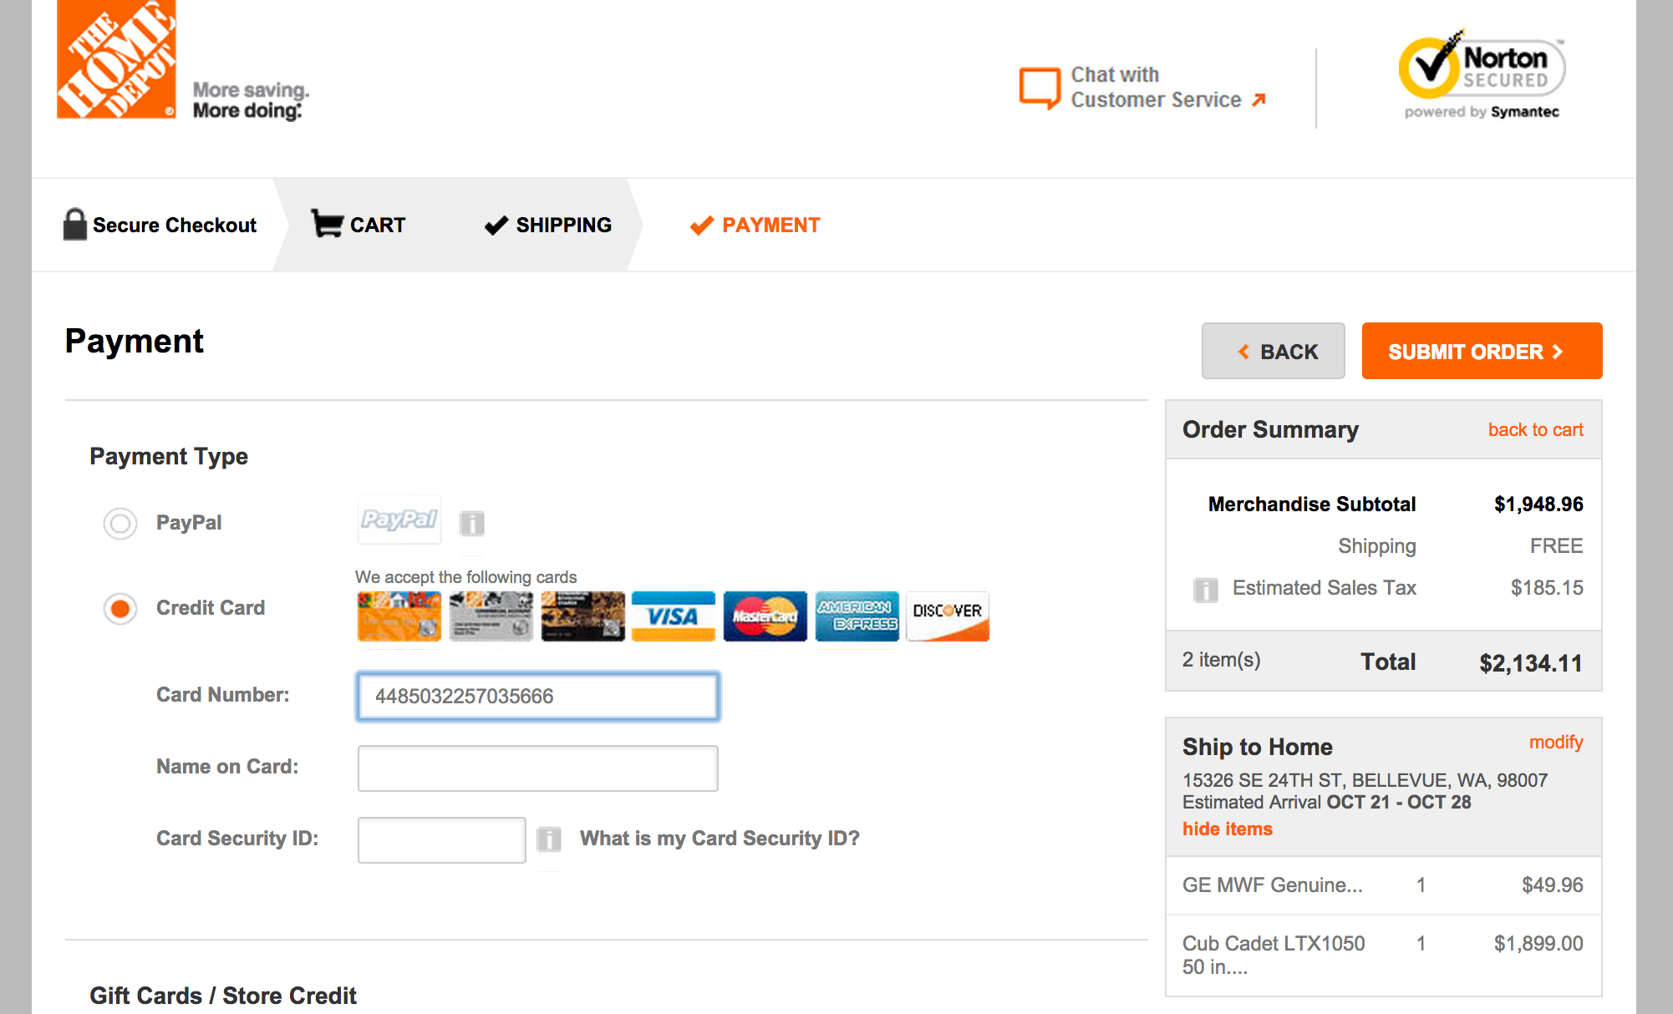

Slide 51
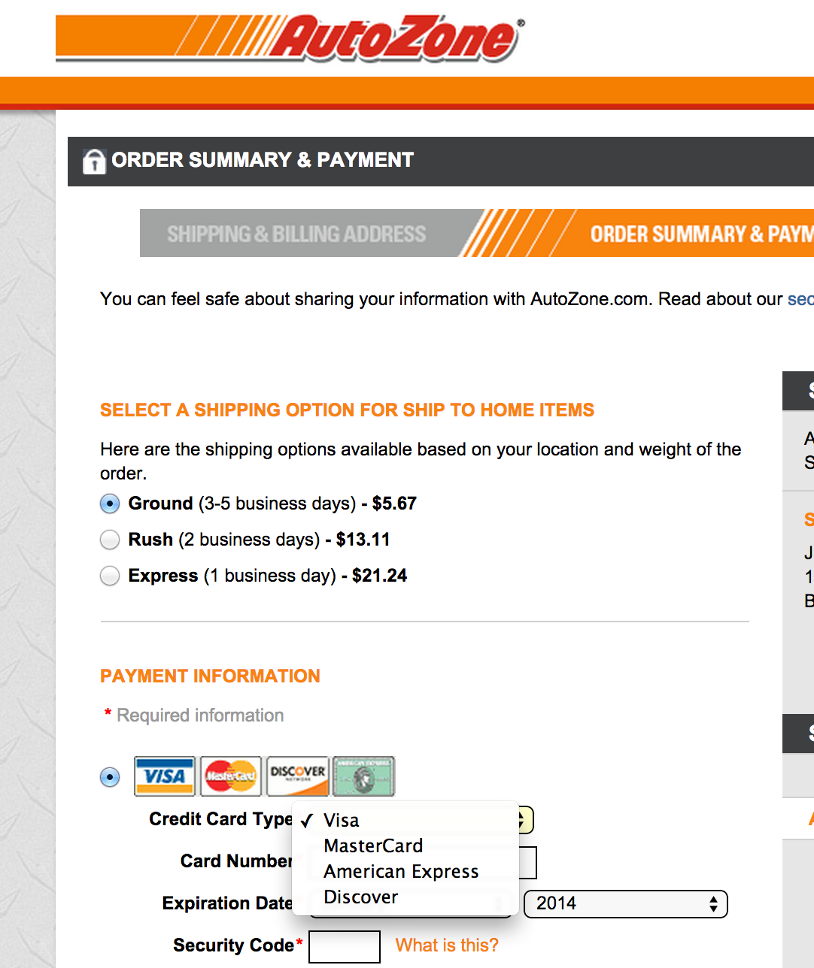

Slide 52
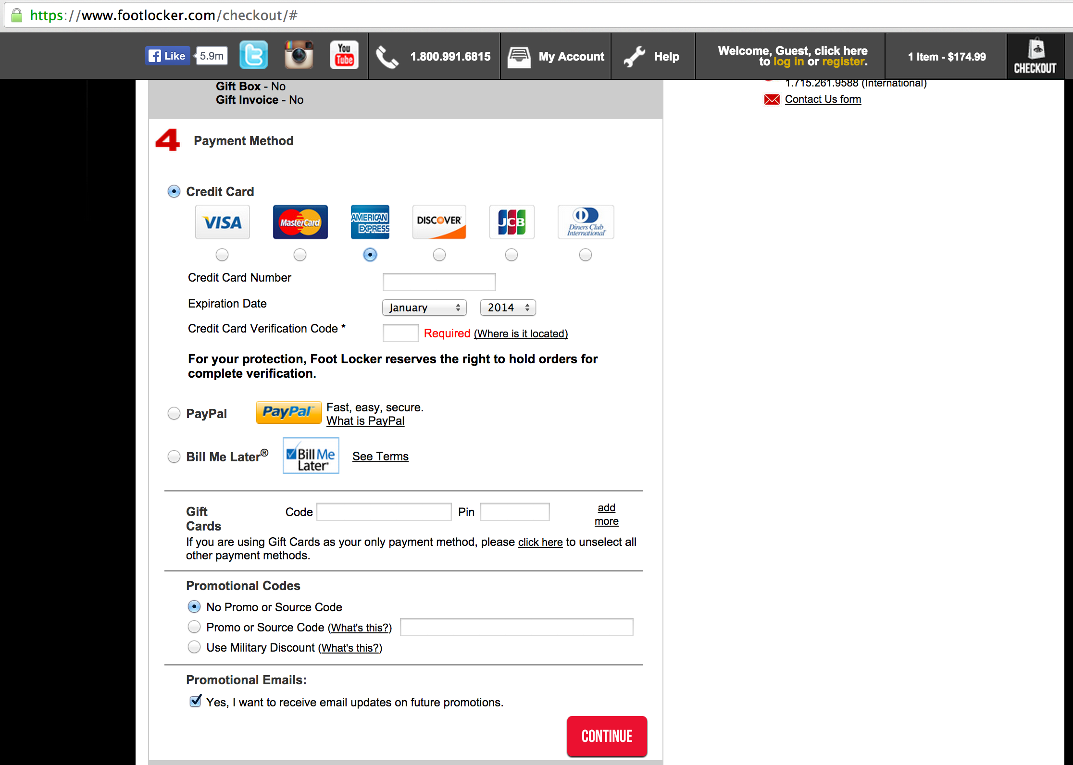

Slide 53
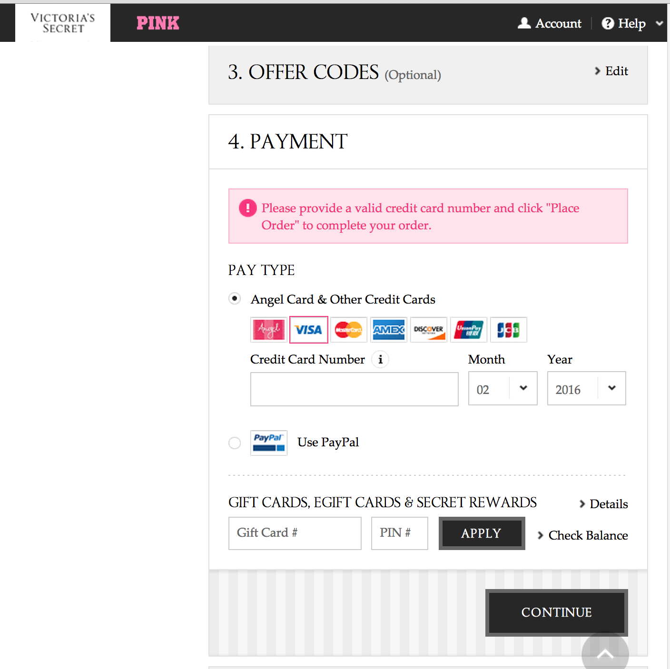

Slide 54
http://jquerycreditcardvalidator.com/

Slide 55
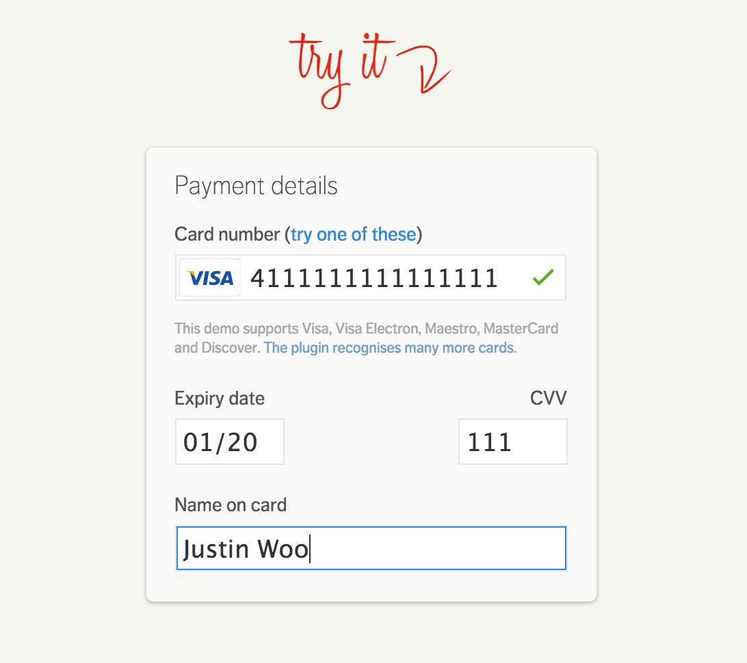

Slide 56
Not limiting the number of digits

Slide 57
Card | Number of Digits
AMEX | 15
Visa | 13 or 16
MasterCard | 16
Discover | 16

Slide 58
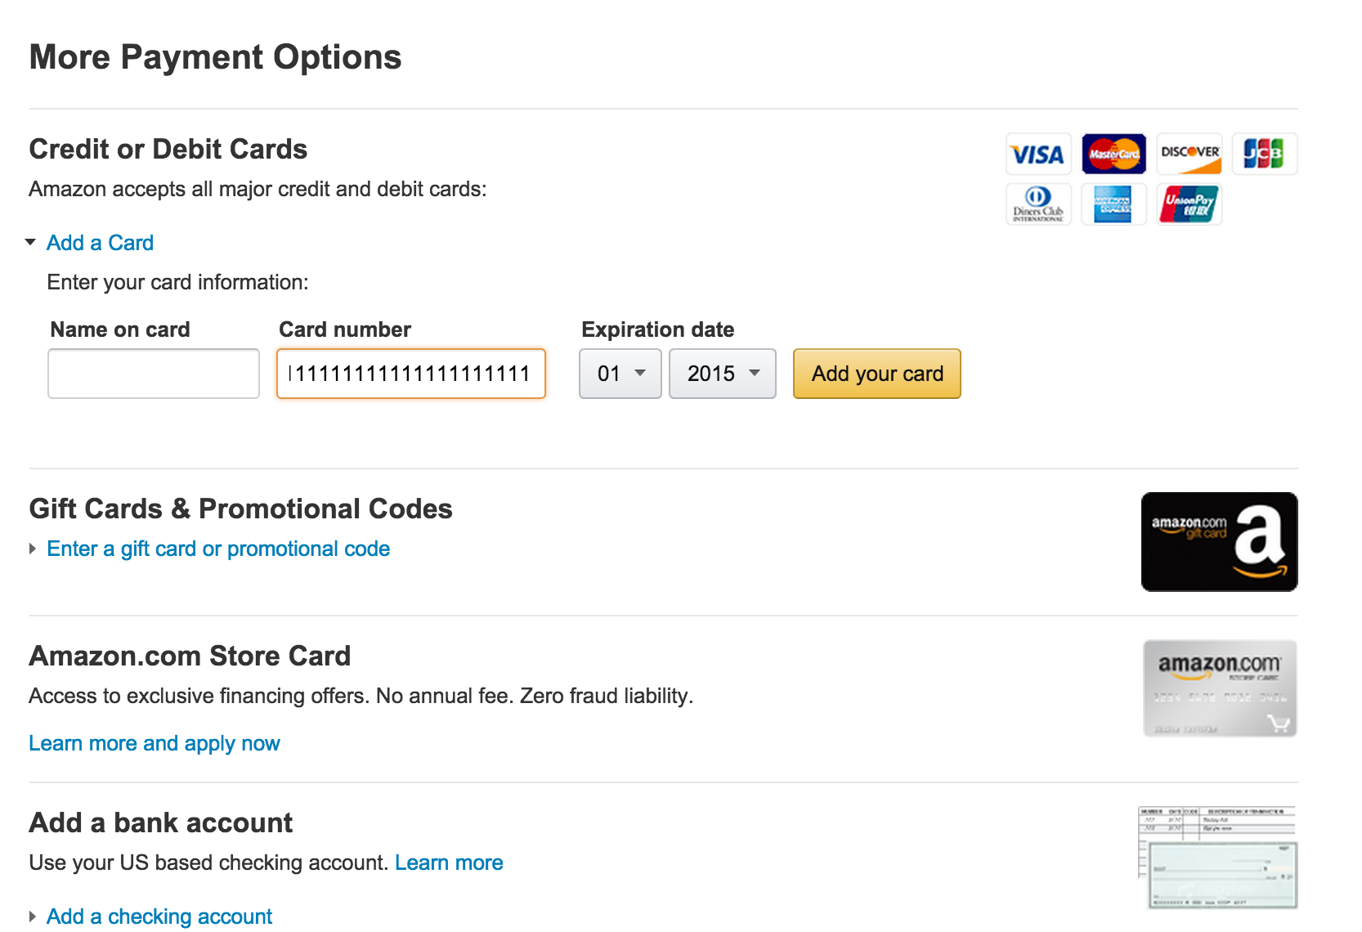

Slide 59
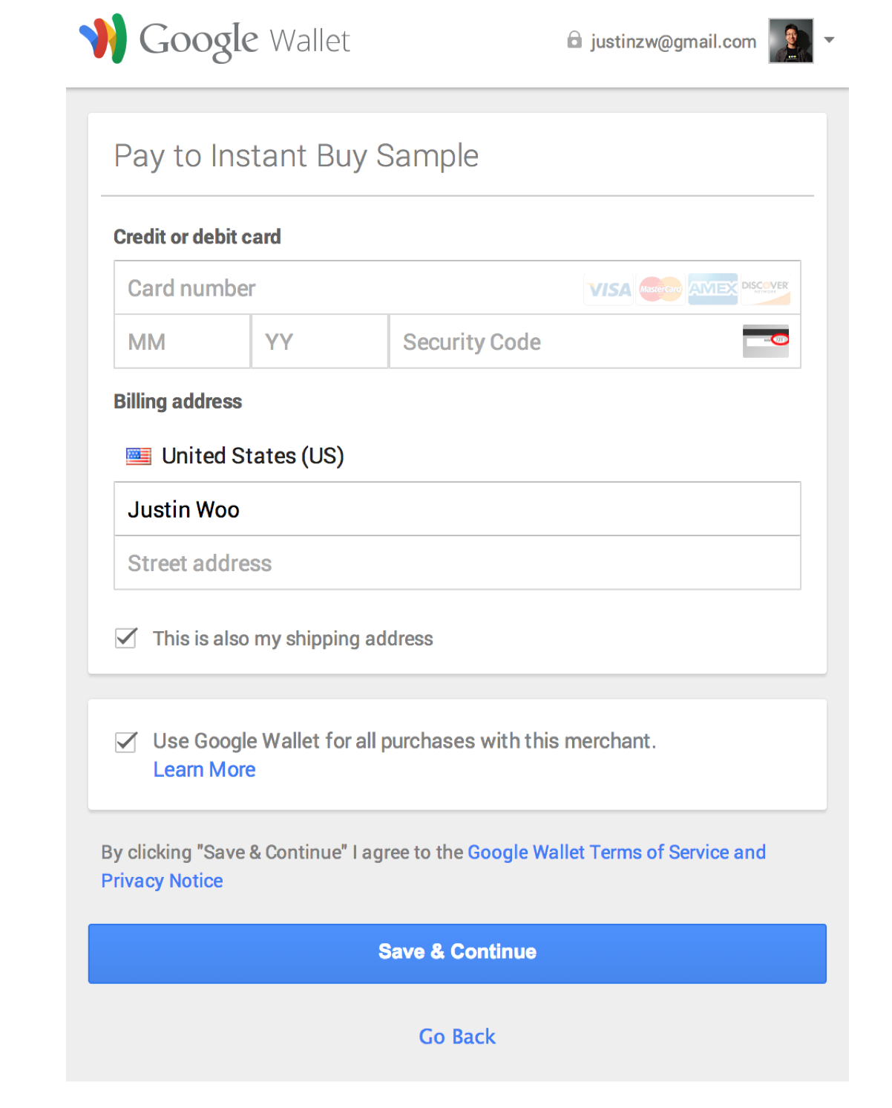

Slide 60
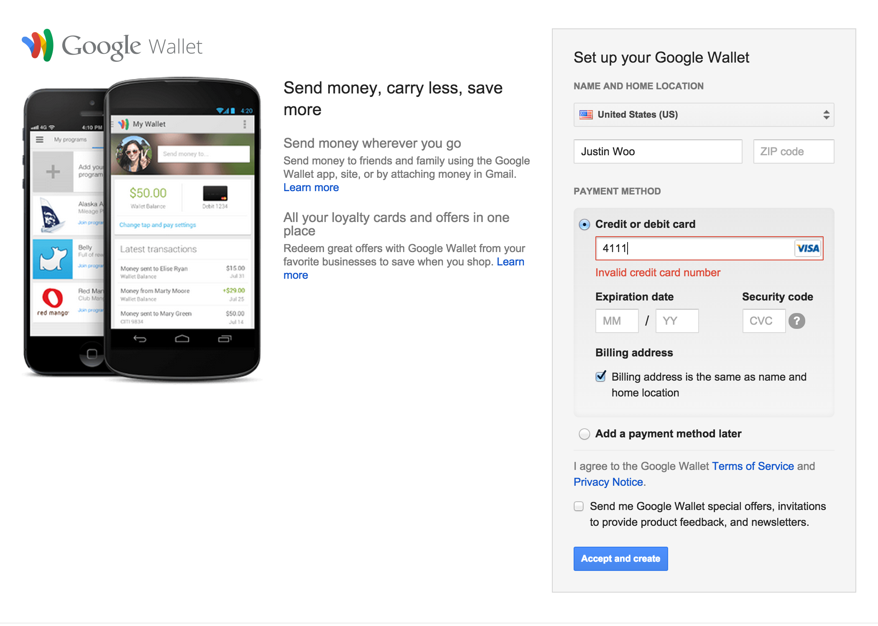

Slide 61
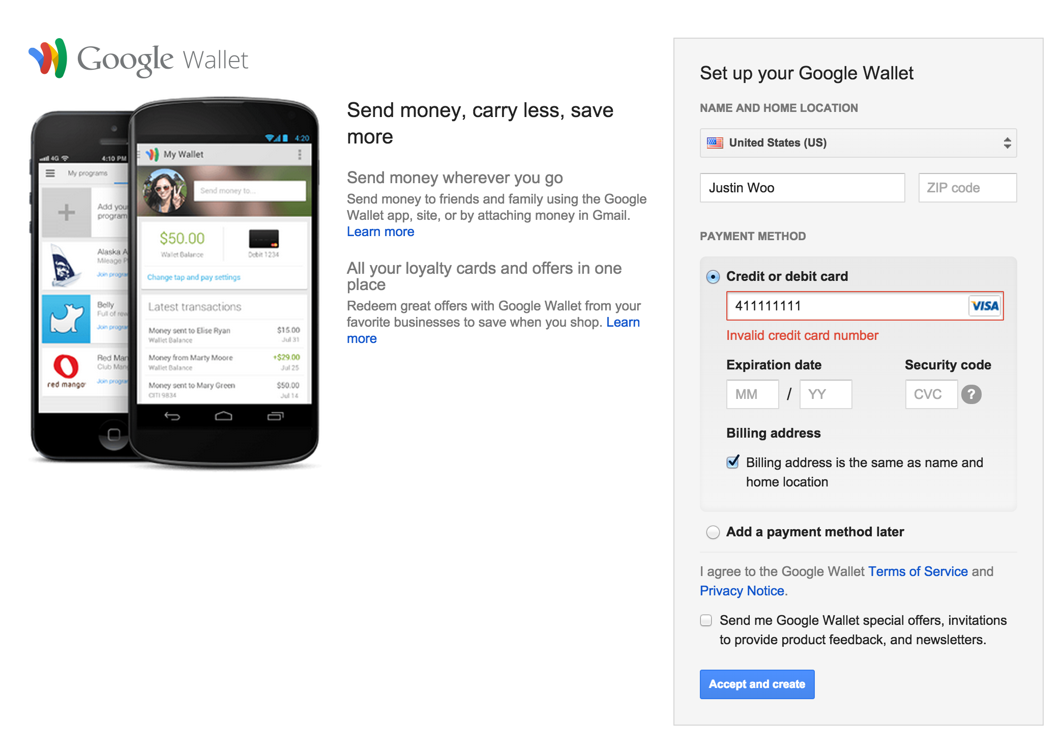

Slide 62
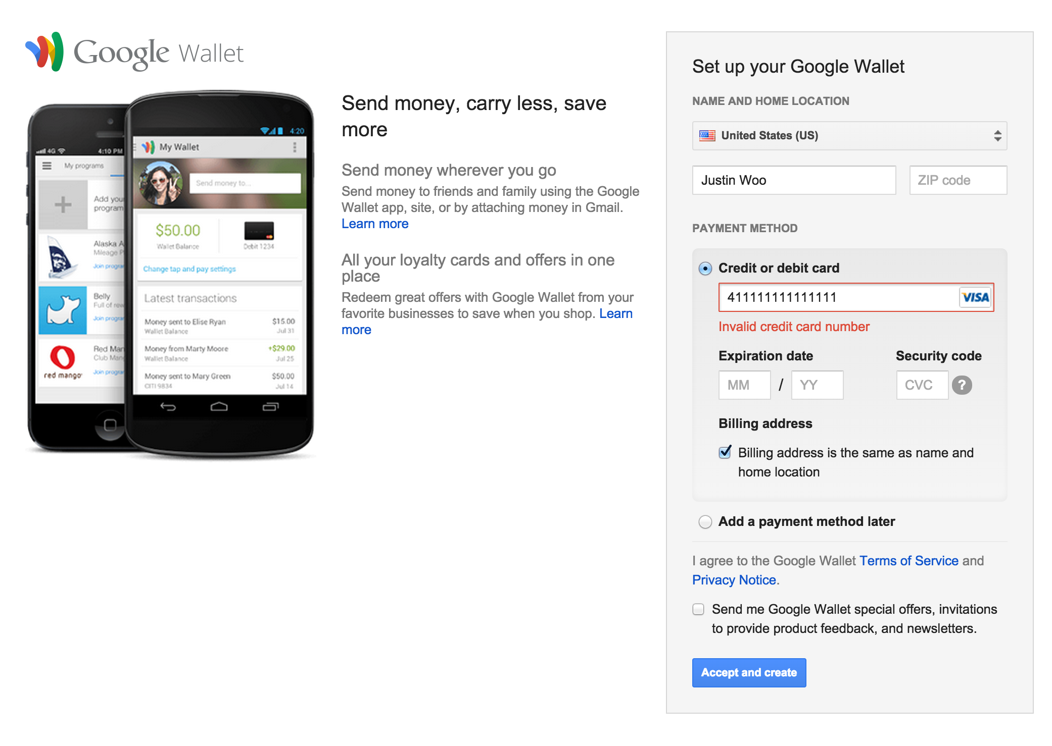

Slide 63
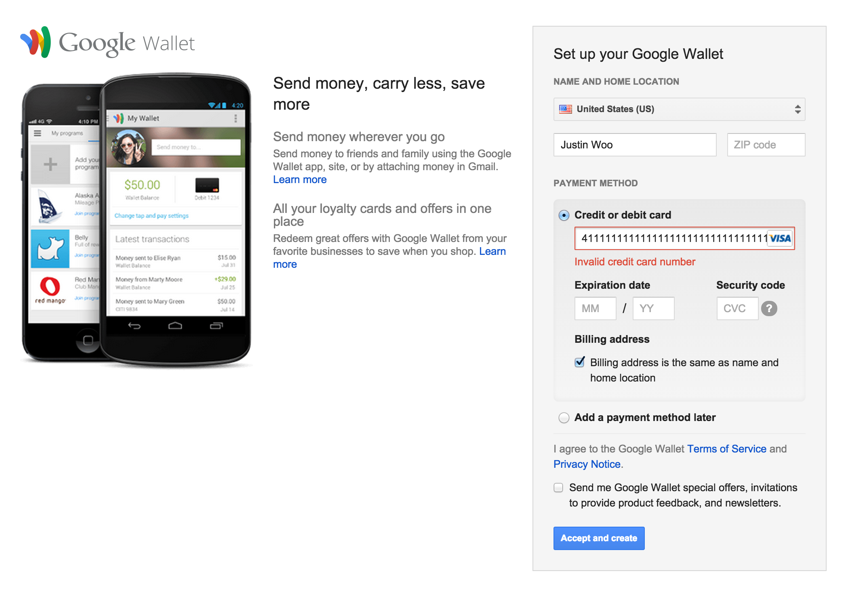

Slide 64
http://zdfs.github.io/toscani/paymentInfo/index.html

Slide 65
You lost me at the
Card Security Number

Slide 66
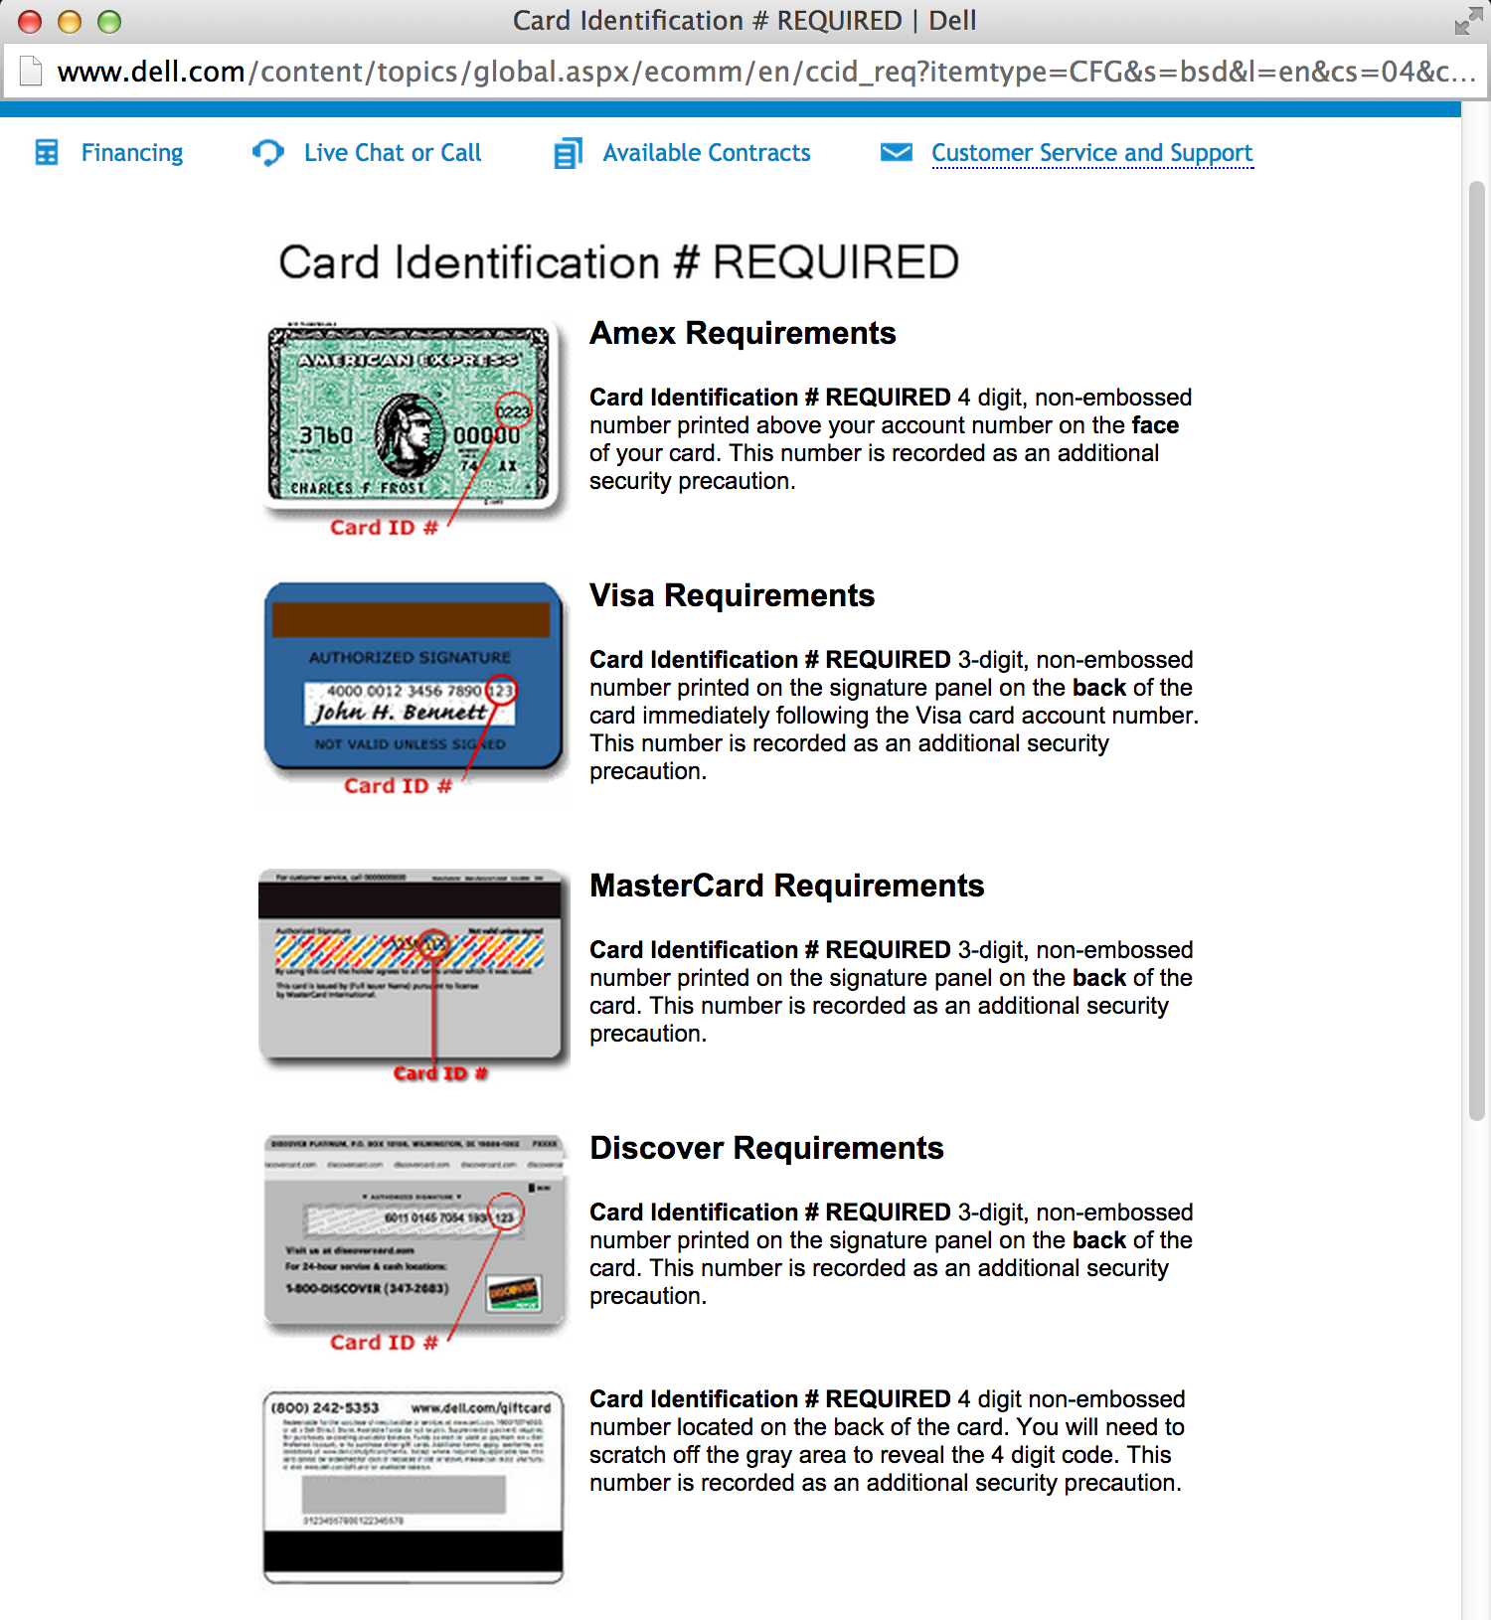

Slide 67
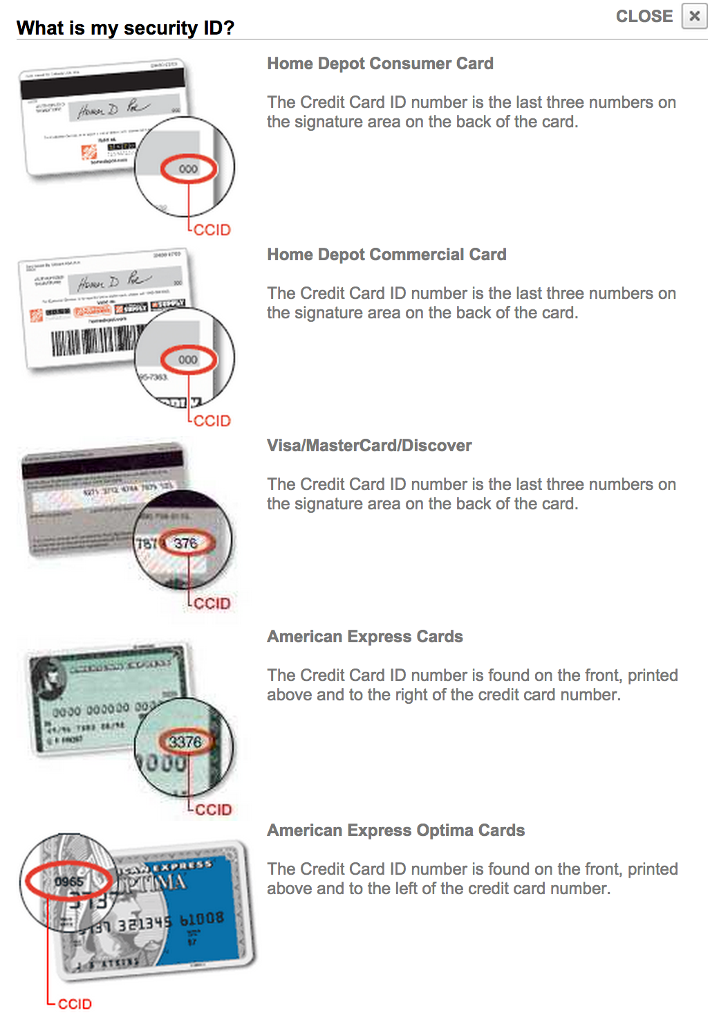

Slide 68
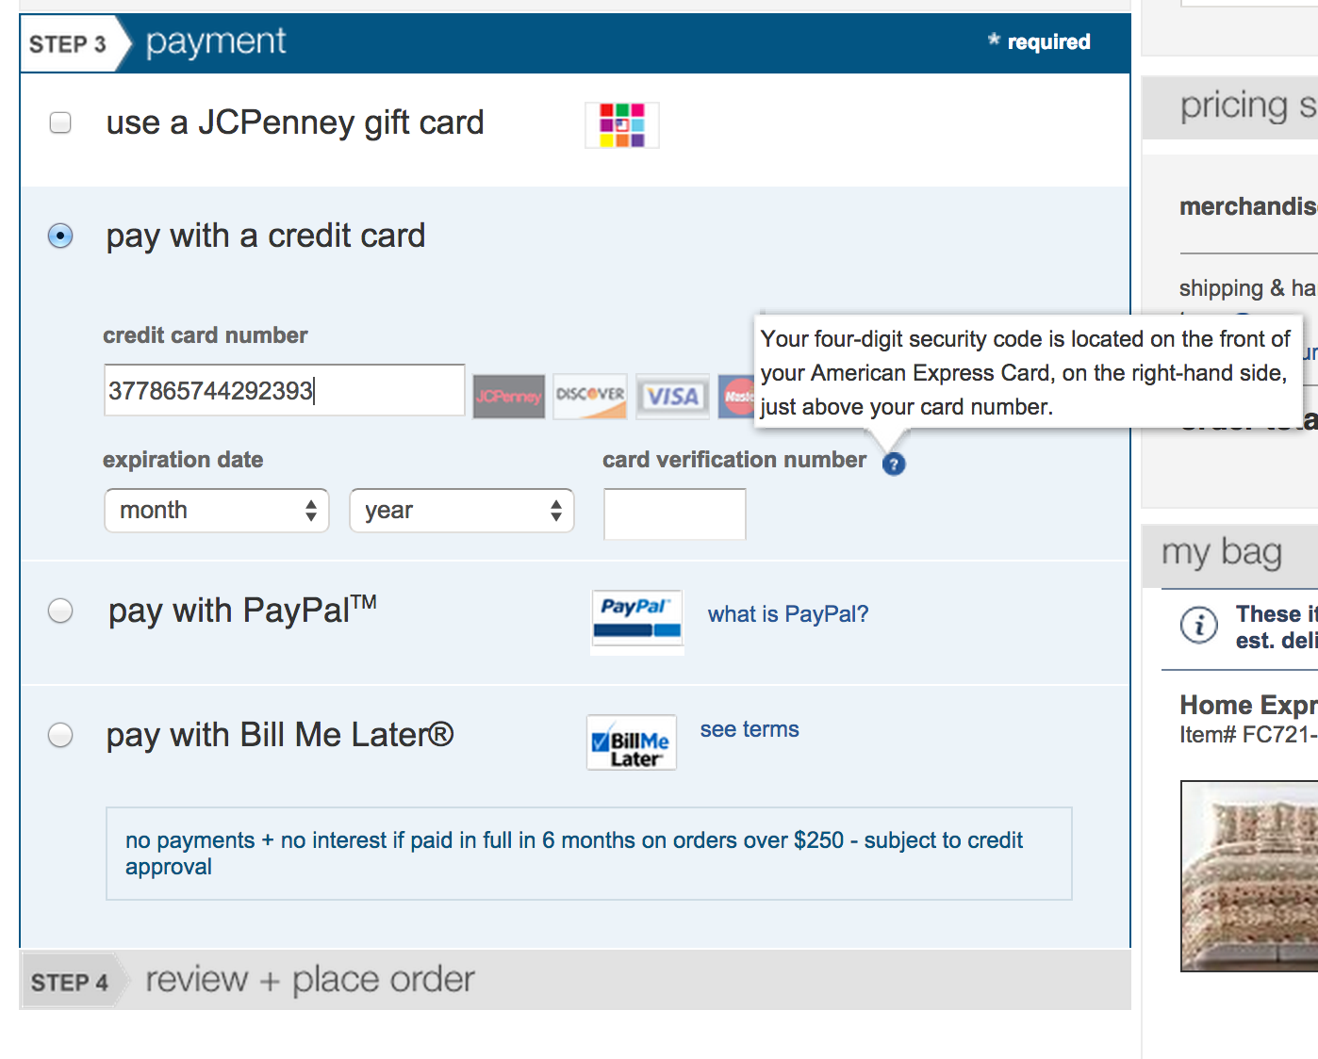

Slide 69
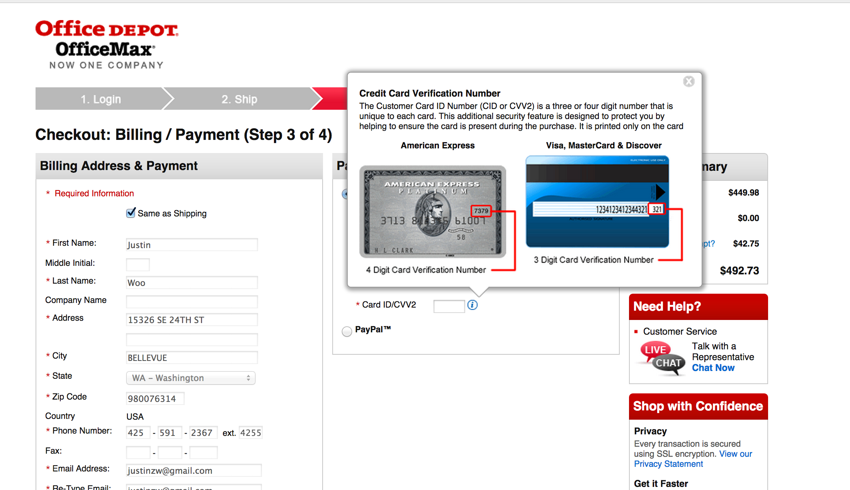

Slide 70
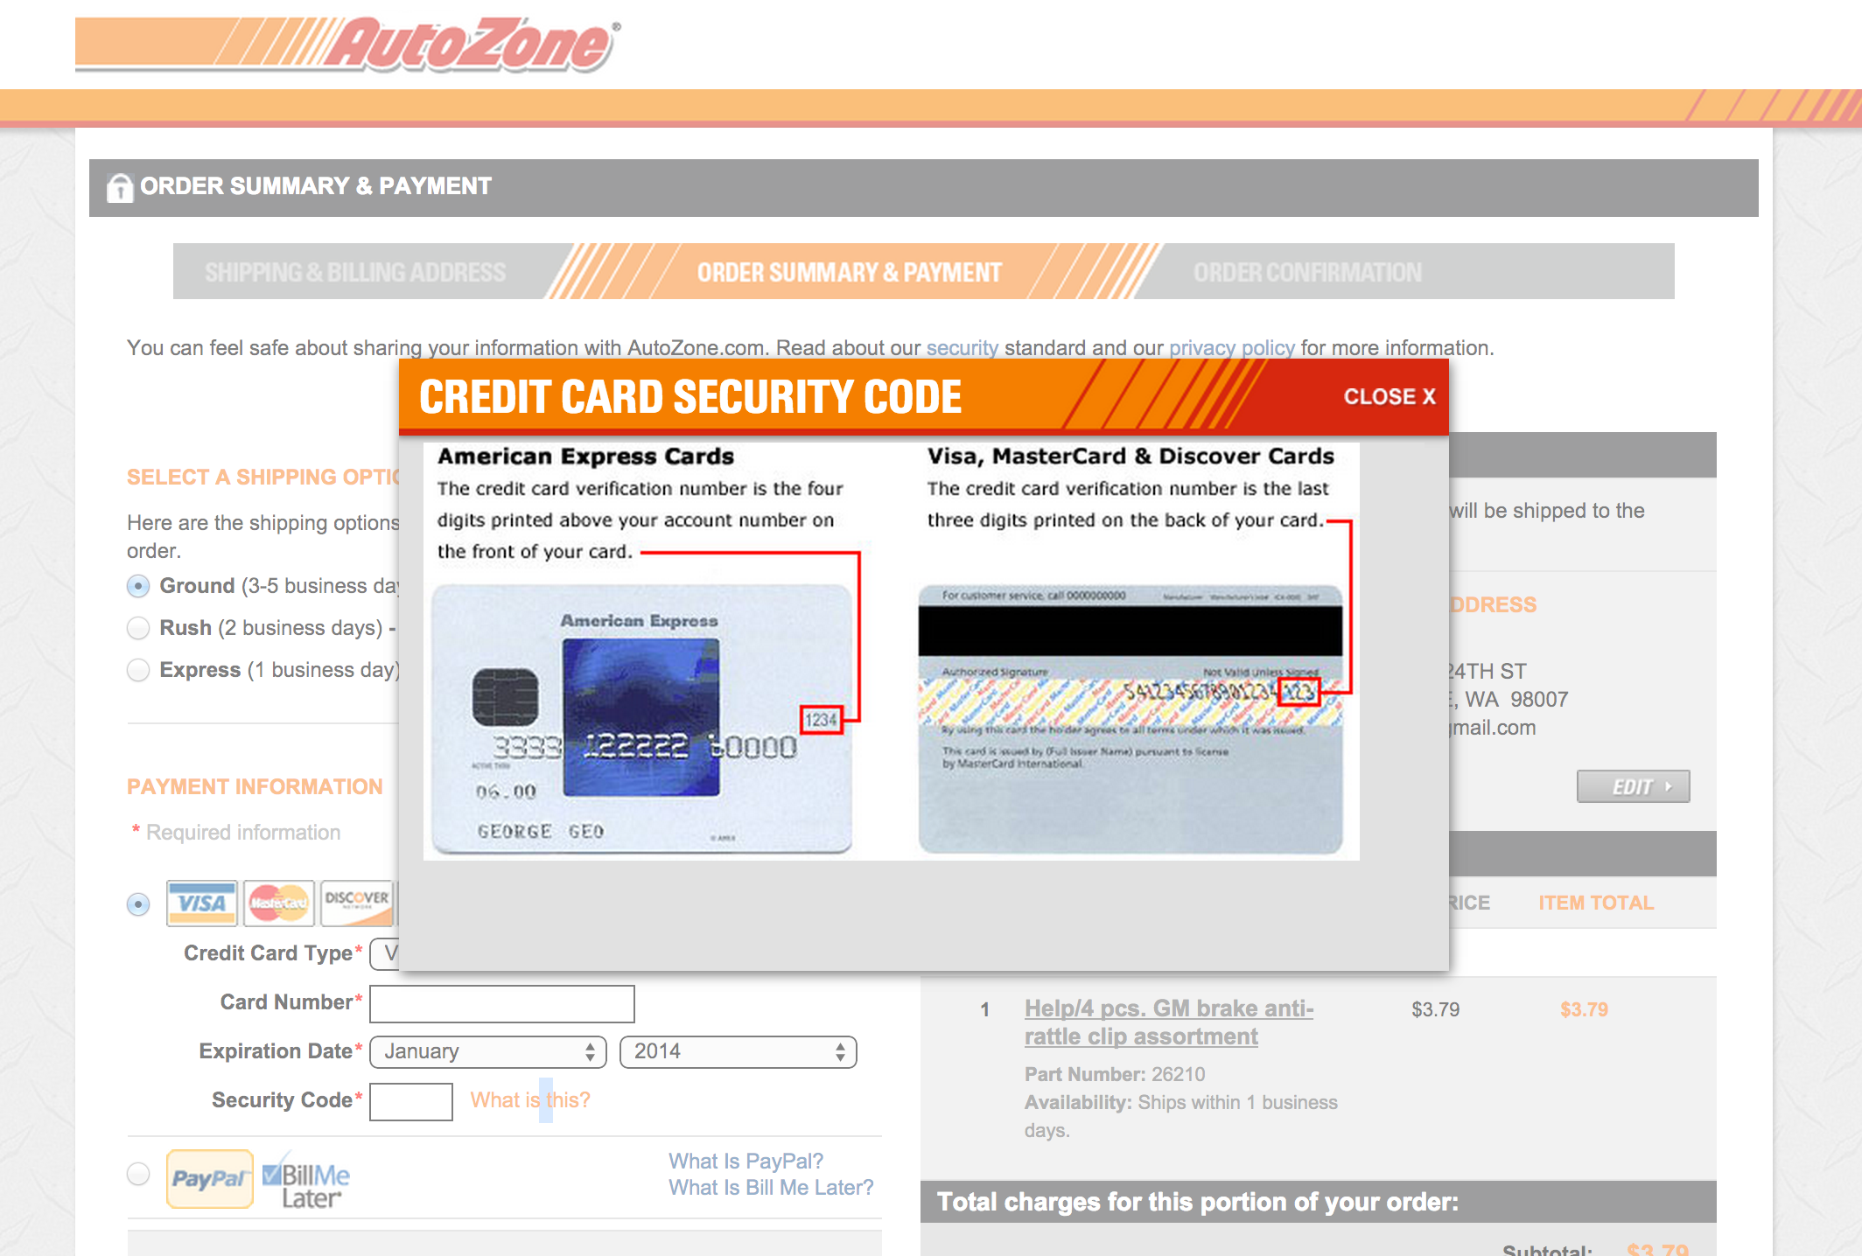

Slide 71
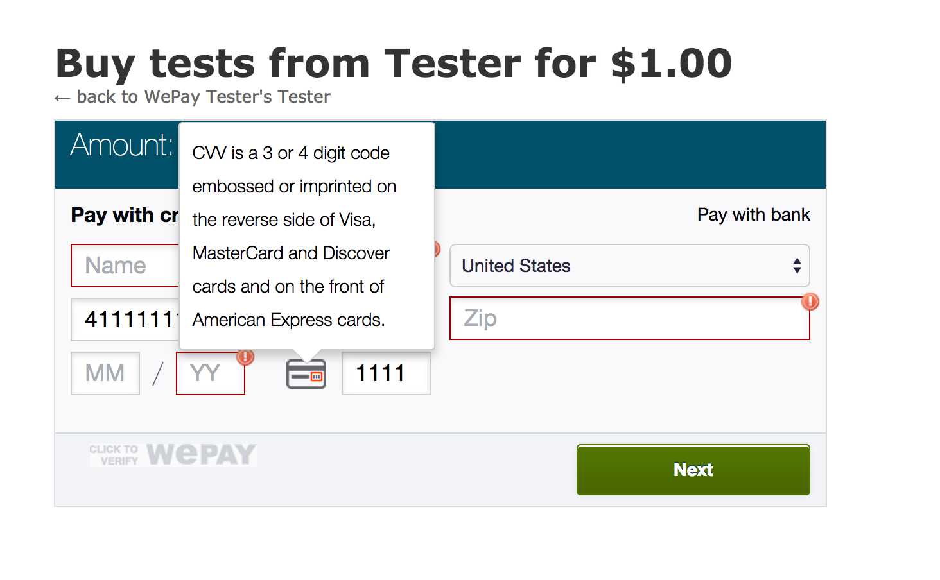

Slide 72
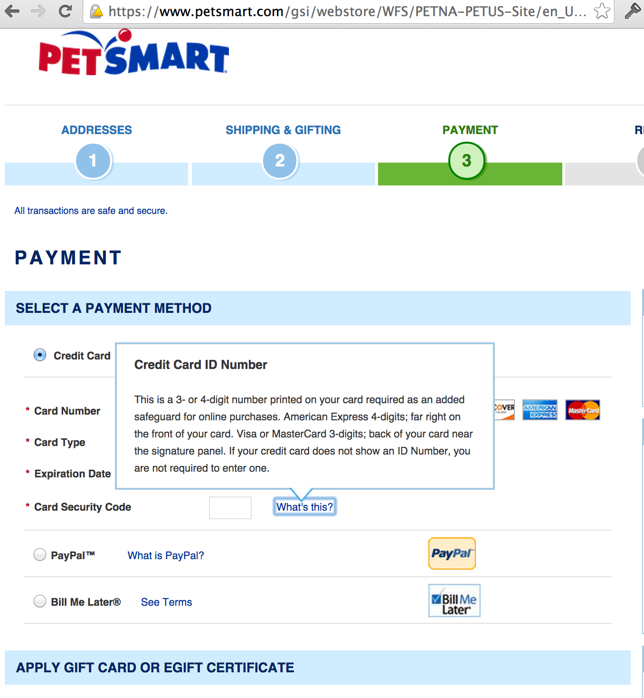

Slide 73
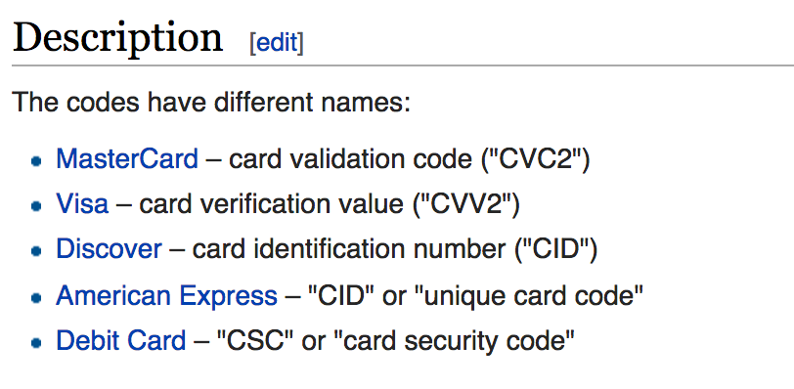

Slide 74
http://jessepollak.github.io/card/

Slide 75
http://kenkeiter.com/skeuocard/

Slide 76
An American Express walks
into a bar in Moscow……

Slide 77
the bartender says,
“Sorry mate,
You aren’t allowed in here without a ….”

Slide 78
“Visa”

Slide 79
Not provide me a calendar view when selecting dates

Slide 80
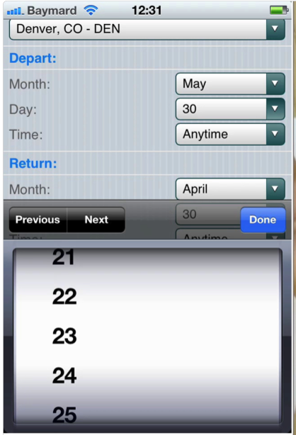

Slide 81
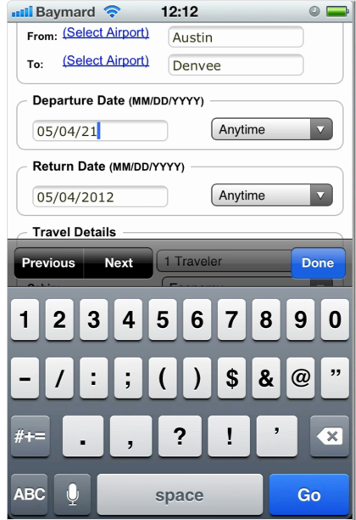

Slide 82


Slide 83
Not Validate
Credit Card # field
Inline

Slide 84
Luhn algorithm

Slide 85


Slide 86


Slide 87
4217 6511 1111 1119

Slide 88
4217 6511 1111 1119
9111 1111 1165 7124

Slide 89
4217 6511 1111 1119
9111 1111 1165 7124
9212 1212 1260 7228

Slide 90
4217 6511 1111 1119
9111 1111 1165 7124
9212 1212 1260 7228

Slide 91
4217 6511 1111 1119
9111 1111 1165 7124
9212 1212 1260 7228
14 + 6 + 11 + 19 = 50

Slide 92
4217 6511 1111 1119
9111 1111 1165 7124
9212 1212 1260 7228
14 + 6 + 11 + 19 = 50
50 % 10 == 0?

Slide 93


Slide 94


Slide 95


Slide 96


Slide 97
Long scrolling lists

Slide 98


Slide 99


Slide 100
Not show appropriate keyboard layouts

Slide 101


Slide 102


Slide 103

Notes:
Number then letters?

Slide 104

Notes:
Not possible to put dash

Slide 105
http://mobileinputtypes.com/

Slide 106


Slide 107


Slide 108


Slide 109


Slide 110

http://stackoverflow.com/questions/25945138/how-do-i-set-up-a-web-form-to-support-ios-8-credit-card-scanning-in-mobile-safar

Slide 111
Not disable auto-correct when appropriate

Slide 112


Slide 113


Slide 114


Slide 115


Slide 116
<input type="text" autocorrect="off" />

Slide 117


Slide 118
I Have a Dog

Slide 119
Who is Blind…BUT

Slide 120
Thinks he can see?!?!

Slide 121


Slide 122
People always want to pet him..
especially kids!!!

Slide 123
I wrote an application that….

Slide 124
charges people when they want to pet him

Slide 125
I know what you are thinking

Slide 126
I’m an a**hole

Slide 127
I’m actually trying to raise money for his eye surgery

Slide 128
I promise!!!

Slide 129
Making Payments Fun

Slide 130

Notes:
shoppers to quickly discover and buy products on a wider variety of platforms.

Slide 131

Notes:
Browsy – Makes Pinterest Boards automatically shoppable
Soldsie – Monetize Facebook/instagram, seller uploads image and followers can comment “sold” to purchase
Pixbi – Allows Magazine readers to purchase products through Magazine imagery

Slide 132


Slide 133

Notes:
‘In a Snap’ – Uses image recognition technology. Snap a photo to see whether item is available in Target
Snapup – Take screenshots of products they are interested in, adds them to wishlist, tracks price point and availability
Hiku – Scan Barcodes at home and to shopping list. Voice to dictate shopping list out loud.

Slide 134

Notes:
paring down the interface into an experience that is more visual, personal and easier to navigate.

Slide 135

Notes:
Spring- a vertical feed somewhat similar to Instagram’s interface. Upon signing up, users are given a list of retail brands whose products customers can scroll through, which they can add or remove based on preference
Kwoller- Tinder like personal Store Front
Clinique- created an app to watch informational videos and live chat with online representatives

Slide 136

Notes:
Mobile sensor technologies like geolocation and in-store beacons are being leveraged to give consumers a more personalized and immersive experience each time they shop.

Slide 137

Notes:
UrbanOn, sends notifications prompting shoppers to log in through social media when entering the store, and then serves relevant messages. Selfies in changing room PlaceUs is a tracking app that leverages that users tend to repeatedly visit the same locations. In stores, it can recognize recurring purchases such as a coffee order at a cafe and automatically place the order.
Quirky partnres with weather app Poncho - to run AC ads when local temps rise above 75 farenheits.

Slide 138

Notes:
trigger a predetermined set of next steps.

Slide 139

Notes:
Dorothy- IFTTT
Zappos created the Gear Tracker feature that integrates with MapMyFitness and tracks the mileage their shoes cover
Google- can now set up low balance alerts to keep track of their funds.

Slide 140

Notes:
help bridge the gap between online and offline shopping behaviors

Slide 141

Notes:
StreetHub is an iOS app that lets shoppers purchase items from their favorite London boutiques online then collect the items in store or have them delivered
Walgreens - showing where products are on shelves to offer highly contextual discounts. For instance, as someone walks down the aisle, a notification might pop up on their mobile phone suggesting they visit the cold drinks section to get reward points
StockNearby – is it stocked in your correct size?

Slide 142


Slide 143


Slide 144

Notes:
sustainable ways to accept their shoppers’ social media activity and personal data as concrete forms of payment.

Slide 145

Notes:
Onepiece- Instagram users who have aggregated 40,000+ followers’ could receive discounts on products at the OnePiece retail store New York City
Styleboard- someone makes a purchase through a user’s unique link, the poster is awarded a small sum
Marc Jacobs- Tweets with the hashtag #MJDaisyChain could be redeemed for in-store credit, and extra credit was redeemed for tweets including an uploaded image or video.

Slide 146

Notes:
Alternative currencies like Bitcoin

Slide 147

Notes:
Fastacash- allows users to transfer value (money, airtime, other tokens of value)
Coins.ph- the app lets users buy and sell Bitcoin, store the currency in their digital wallet and keep track of the market
Shift is a new credit card-sized device that allows users to pay with their traditional bank accounts, loyalty points, and even virtual currencies.

Slide 148


Slide 149


Slide 150


Slide 151

Notes:
Bid2Pay- Before a buy, the user logs into the app and auctions off the purchase and method of payme
Thanx - enables consumers to collect loyalty points on their mobile purchases by simply registering their existing credit card.
Taobao- In cooperation with China’s three major telecom operators, the new service allows merchants on Taobao, Tmall or affiliated platforms to gift small sums of mobile data to their customers.

Slide 152

Notes:
automating the details and connecting each step of the purchase path into one fluid service.

Slide 153

Notes:
Keep- Keep is a mobile app that lets users select merchandise from multiple vendors across the Web and add it to a single cart and expedite checkou
Reserve- secure reservations at nearby restaurants as well as expedite the payment process following a mea
Starbucks-2015 will be able to have a standing order of morning coffee automatically ordered, paid for and delivered to their desk

Slide 154
A Credit Card Form walks
into a bar……

Slide 155
the bartender says,
“You are new to this joint aren’t you?”
The credit card form
looks at him and says
“Yeah, I just……

Slide 156
“discovered” it

Slide 157

Justin Woo
[Developer Advocate]
Venmo + Braintree + PayPal
ppd.io/dn
juwoo@paypal.com
@jzwoo

